Slide 1
Purpose of this deck
Speaker: | In-house Specialist, Microsoft Spokesperson or Partner (Leader/Exec/SME)​
Audience: | Business Decision Maker, Line of Business Owner or an IT Decision maker
Title: | Transition to Synapse Link – simplify data integration
Length & Version: | 30 minutes, last updated Oct 2023
Content Level: | Level 200 for external & internal use
Deck Contacts: | Microsoft Product team: Jila Yadav, Milinda Vitharana, Jason Huang, Rich Black, Steven Koppens
Desired Outcomes: | Clear understanding of benefits, effort to transition from BYOD, Export to Data Lake to Synapse Link and Microsoft Fabric Proof of concept or planning workshop with an inhouse specialist, Microsoft Services or Partner
Usage Guide: | Slides should be adaptive to the specific audience situation – feel free to reorder slides, hide slides, etc. that you feel fit with your audience and the products they currently use.
Notes:
The purpose of this presentation is to provide you with an example of how best to present this Level 100 pitch deck to non-technical, business decision makers (BDMs). This external facing deck is intended to provide an overview of Dataverse + Microsoft Fabric solution.
For your reference, every slide has comprehensive notes that you can review later. The notes are intended to guide you during customer conversations, so you are empowered with accurate talking points and relevant statistics. Included in the deck are additional industry use cases and features coming soon that you can leverage.

Slide 2
Dynamics data in Synapse Link for Dataverse - Transitioning from Export to Azure Data Lake to Synapse Link

Slide 3
Agenda
What is Synapse Link for Dataverse
What is links to Microsoft Fabric
Transitioning from Export to data lake
Architecture pattern & transition guidance
Additional resources

Slide 4
Synapse Link for Dataverse
1
Unlock Dynamics data for analytics
Notes:
Synapse Link provides access to all your Dynamics data in one experience, enabling you to connect your Microsoft Dataverse data to Azure Synapse Analytics where you can explore your data and accelerate time to insight.

Slide 5

Microsoft Dataverse
Enterprise grade low-code, data platform that manages your data and business logic across the cloud
Business Logic
AI + Analytics
Integration
App + Data Lifecycle
Data Storage
Security + Governance
Notes:
How does Dataverse do that?
By understanding the data and its intent, Dataverse provides turnkey capabilities in a consistent manner over all its data.
It’s not just a database or storage, it encompasses everything that is needed to build integrated applications, processes, and insights across the enterprise.
This comes in many forms - from data storage, to APIs and business logic and events, to reporting and analytics and AI, to security and compliance.
And because it is a low-code data platform, developers can spend more time focusing on business needs through the configuration of the system and less time building infrastructure.

Slide 6
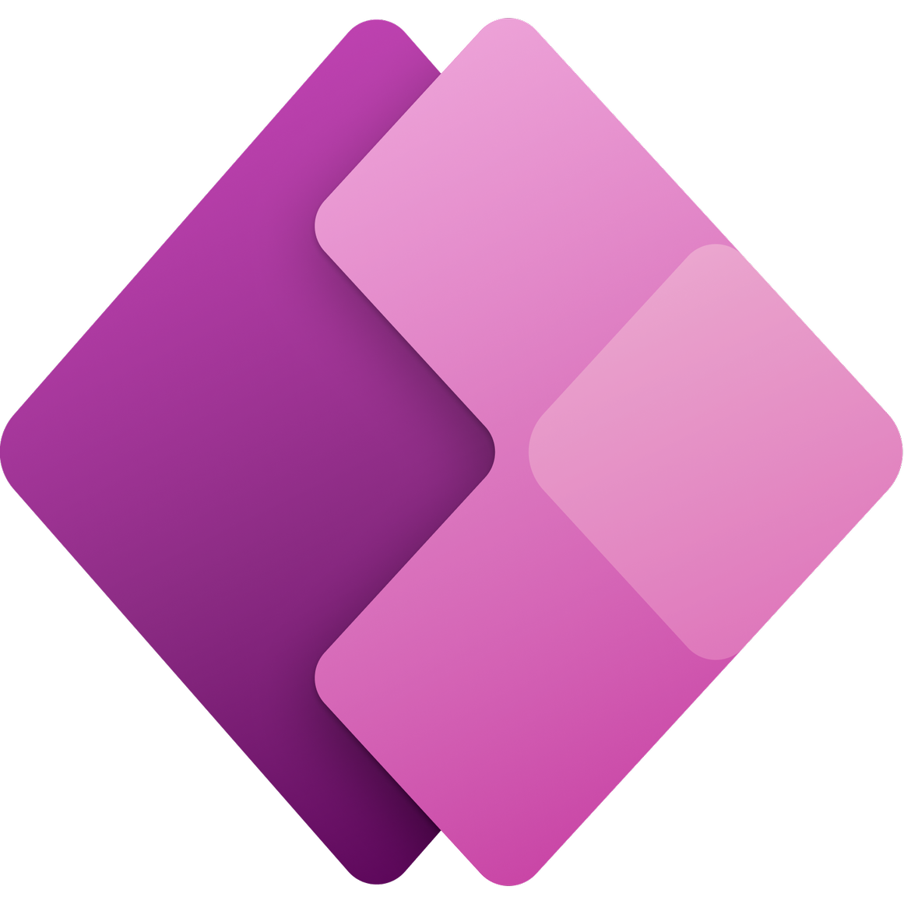
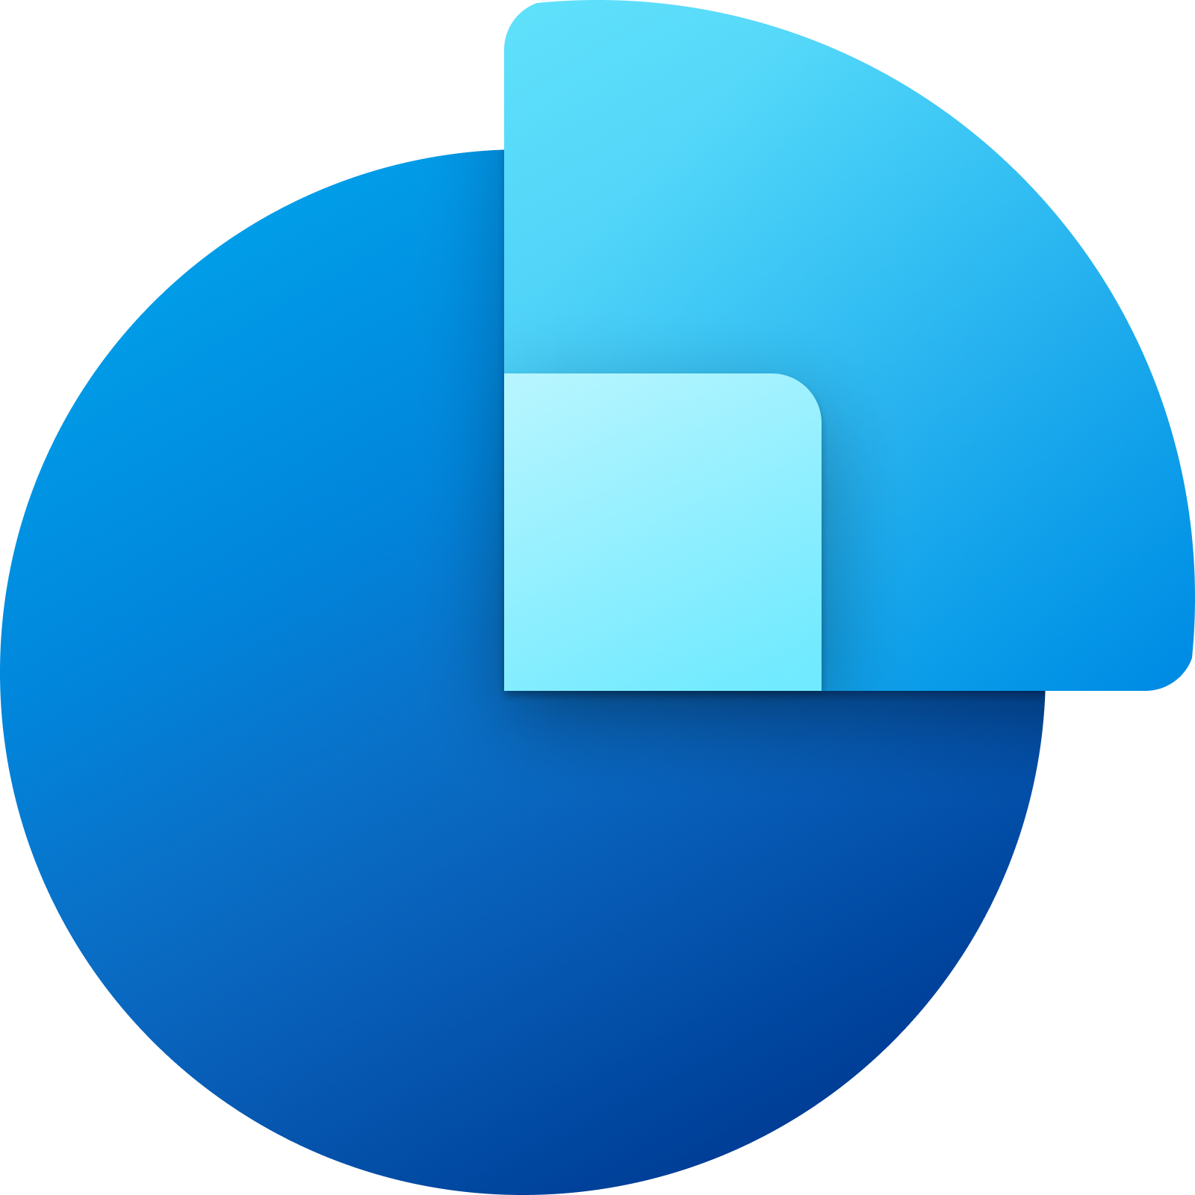

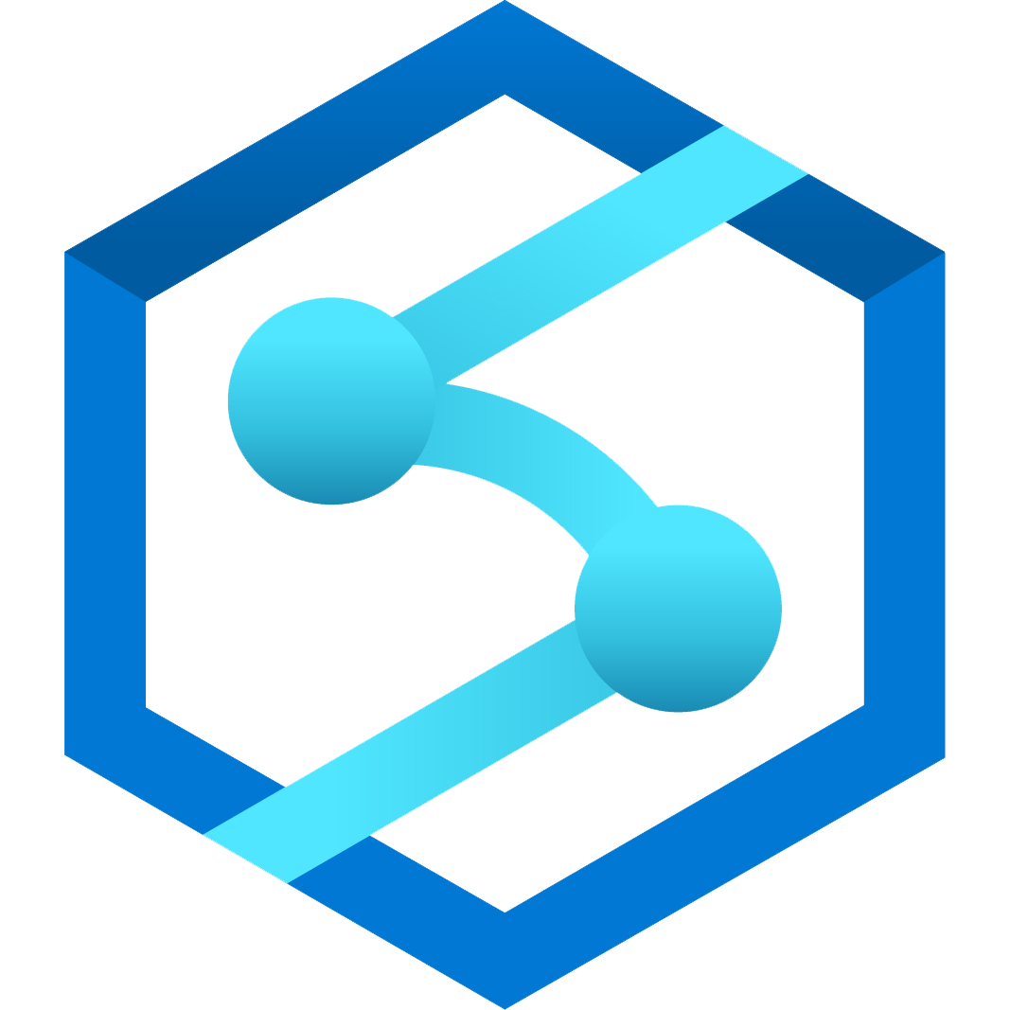




Synapse Link for Dataverse
Synapse
Power Apps
Dynamics 365 Sales
Dynamics 365 Customer Service
One-click export of Dataverse data into Synapse for analytics
Continuous replication of standard and custom tables to Azure Synapse Analytics ​
Now supports F&O Tables & Entities
Dataverse
Dynamics 365 Field Service
Dynamics 365 Marketing
Dynamics 365 Finance and Operations
Notes:
Synapse Link for Dataverse enables Dynapse365 and Power Apps customers to integrate sales, customer service, field service, marketing and Finance and Operations data into Synapse. Once the initial seeding of data is completed, incremental updates will continually run to enable analytics on the most recent and relevant version of the data.

Slide 7
Microsoft Fabric
2
Dynamics 365 and Dataverse
No-copy data integration with Microsoft Fabric

Slide 8
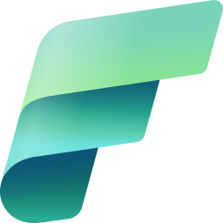


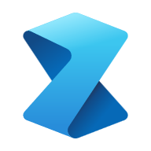



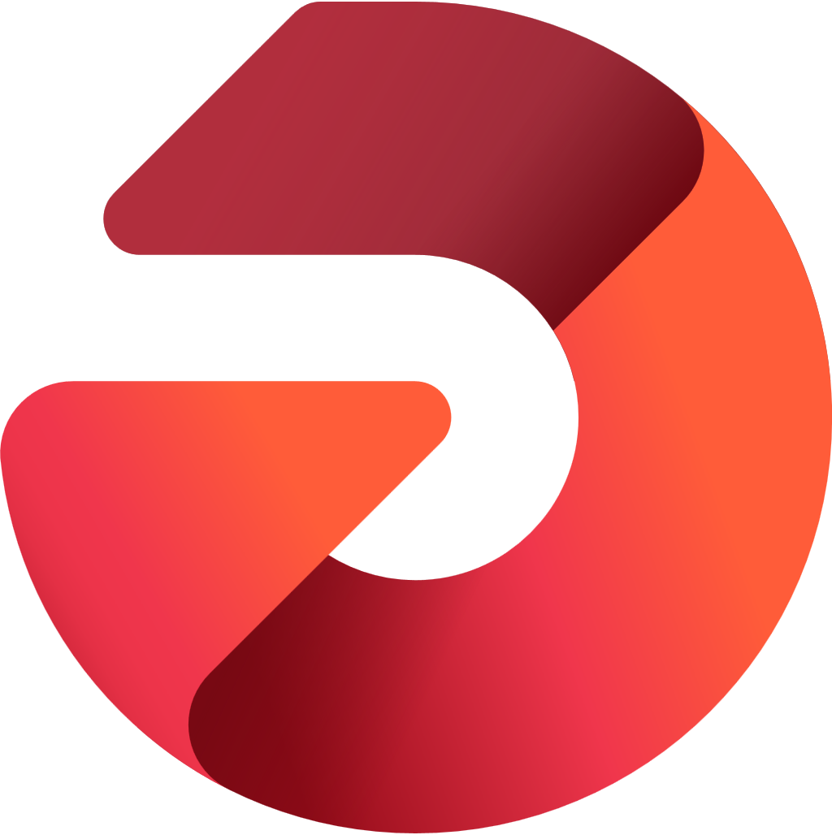

Microsoft Fabric
Data analytics for the era of AI
Data
Factory
Synapse Data
Engineering
Synapse Data
Science
Synapse Data Warehouse
Synapse Real Time Analytics
Power BI
Data Activator
OneLake
Notes:
Microsoft Fabric is an all-in-one analytics solution for enterprises that covers everything from data movement to data science, Real-Time Analytics, and business intelligence... it's a data platform for the era of AI, that accelerates and streamlines the your ability to meet your analytical needs.

Slide 9
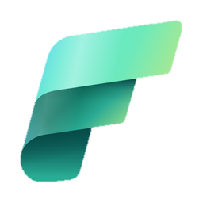

Power platform & Microsoft Fabric
In Public preview
Power Apps
Dynamics 365 Sales
Dynamics & Dataverse data available in Microsoft Fabric immediately, no ETL, no data copy
​
Dynamics 365 Customer Service
Dynamics 365 Field Service
Dataverse
Microsoft Fabric
Microsoft OneLake
Dynamics 365 Marketing
Dynamics 365 Finance & Supply chain
Notes:
If you are using Dynamics or PowerApps, your data is already in Dataverse. With one click, you can work with your data in Microsoft Fabric.

Slide 10

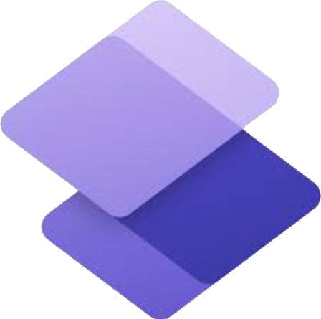



Power platform & Microsoft Fabric
In Public preview
Power Apps
Power
Automate
Dynamics & Dataverse data available in Microsoft Fabric immediately, no ETL, no data copy
Makers can build Apps with insights from Microsoft OneLake no ETL, no data copy
​
Power Pages
Power
Virtual agents
Microsoft Fabric
Microsoft OneLake
Dataverse
Power Fx
AI builder
Notes:
You can use Fabric to work with all the worlds data in One Lake. Data engineers can use SQL, apply AI, combine data, re-shape and build summaries. Get insights on all your data.
Those insights are not useful unless you can take action and drive decisions. With a few clicks, your Data in OneLake appears as tables in Dataverse – you can build Low code apps and build automations.

Slide 11
Transition
3
What’s changing
Why transition?
Business benefits
Expected effort
Notes:
Synapse Link is now fully compatible with finance and operations data, so customers can use this guidance to help transition from Export to Azure Data Lake. In this section, we'll examine what's changing, why the transition is important, what are the expected benefits, and how much effort may be entailed.

Slide 12
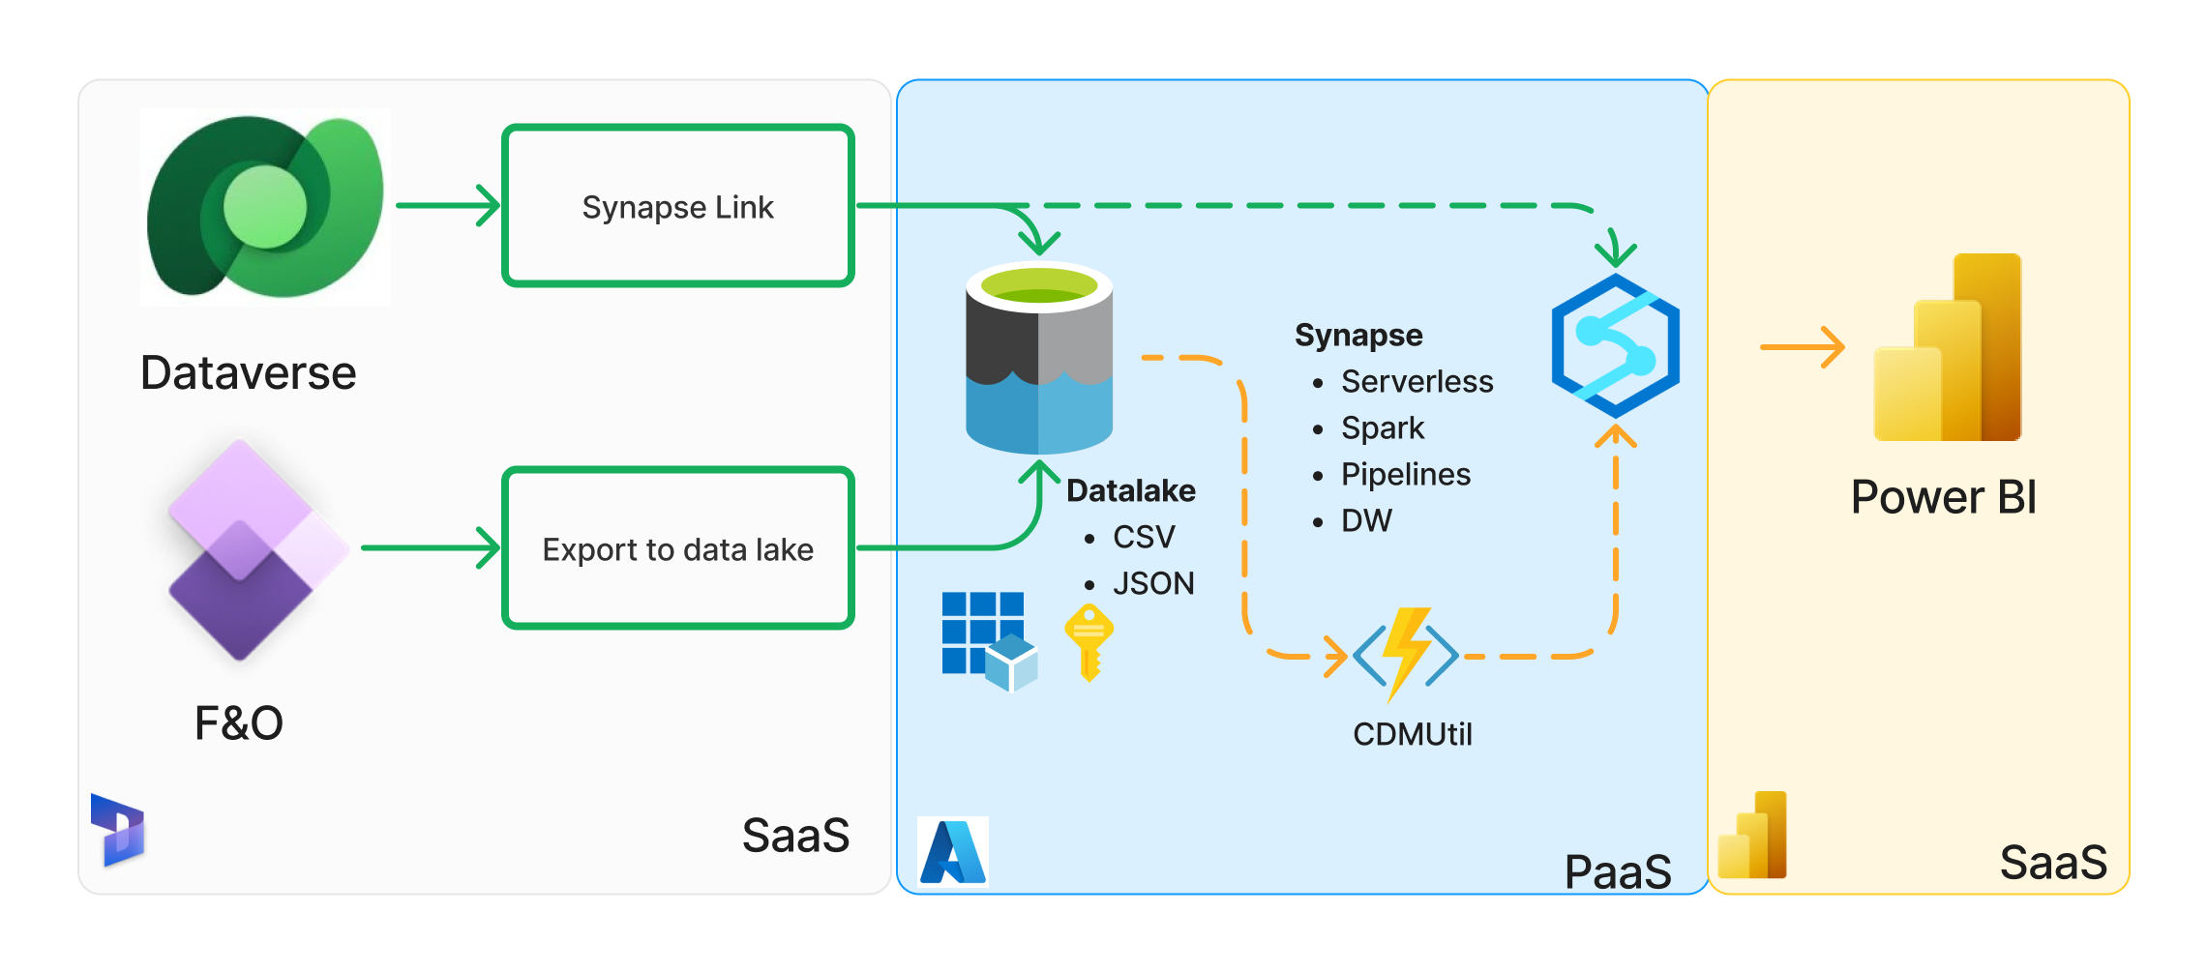
Previously : Synapse Link & Export to Data Lake
Notes:
Previously, Synapse Link moves Dataverse data to your storage account, but Export to Azure Data Lake is needed for F&O data. To work with data from this additional pipeline, additional tools are needed such as CDMUtil, and the CSV file format has performance constraints.

Slide 13
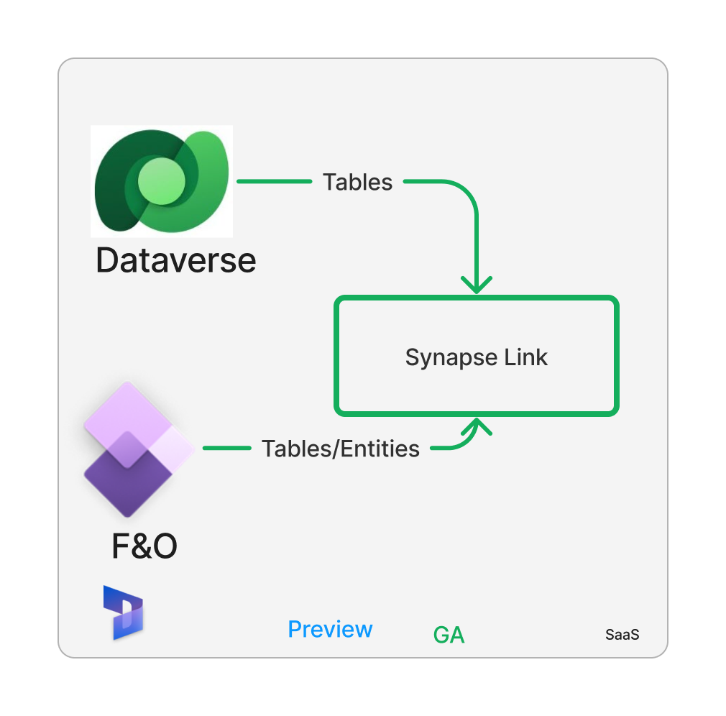
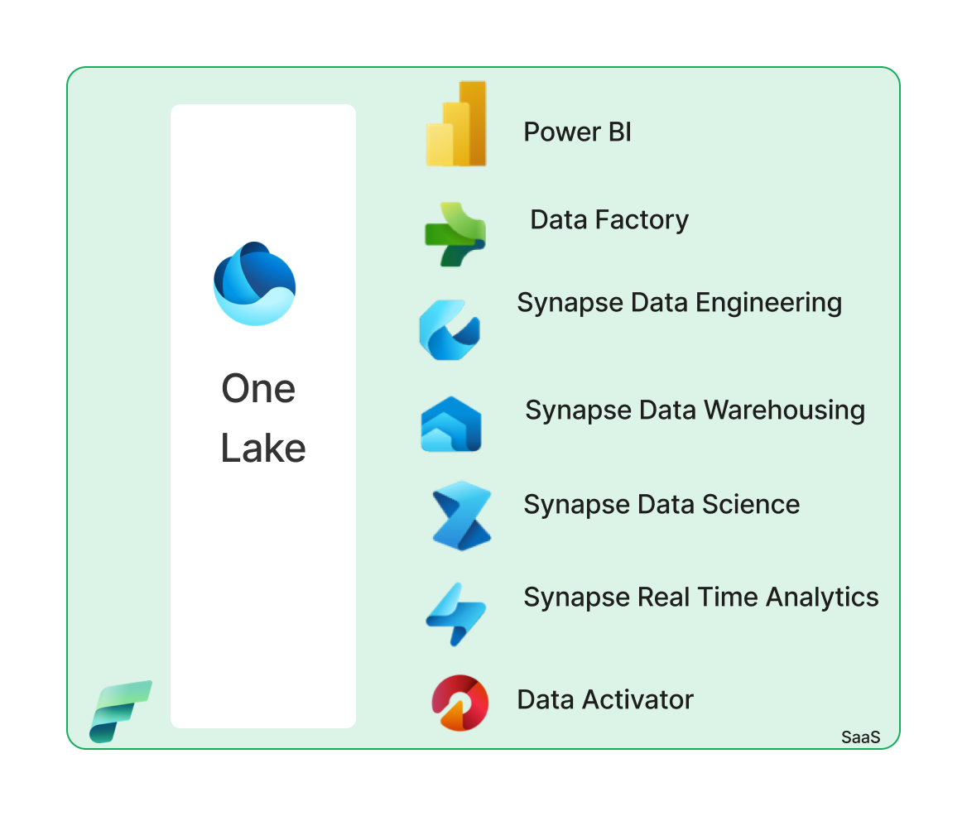
Option 1: Microsoft OneLake with Fabric
Link to Microsoft Fabric
Notes:
You have two

Slide 14

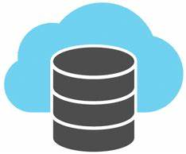
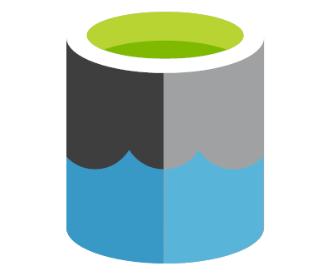
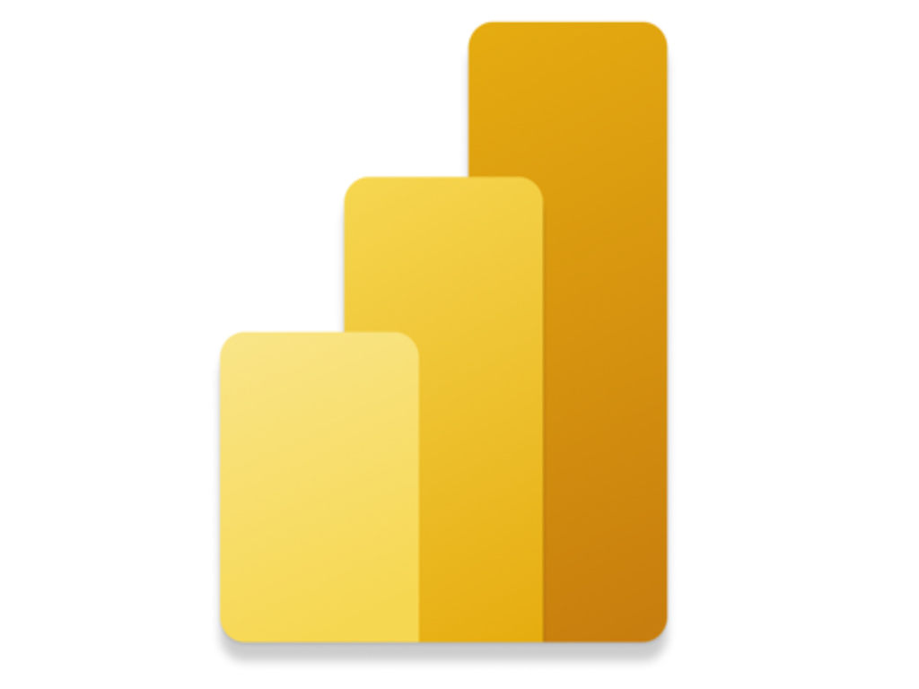




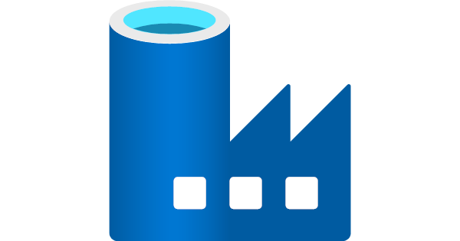
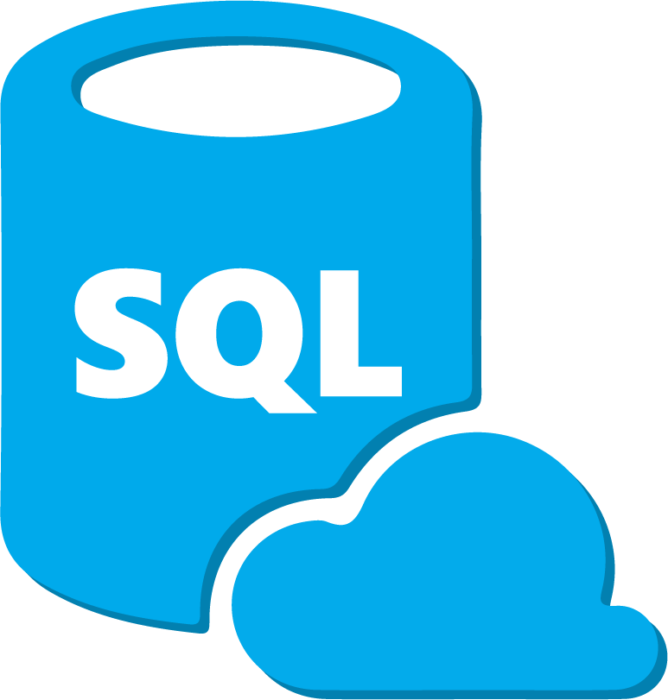


Option 2: Synapse Link- Export to your Data Lake (BYOL)
Optimized Apache Spark
Enterprise data warehousing
Fabric
Near-Realtime Reporting
Azure Machine Learning
Delta/Parquet (live data)
Data Integration and Orchestration
Synapse Workspace
Serverless SQL Query
…
Azure Data Factory
Sink data to any destination with 90+ connectors.
CSV (Incremental data)
Notes:
Now that Synapse Link is compatible with F&O data as well as Dataverse, there is a single tool that is able to use the delta lake / parquet format. From there, no data copy or ingestion is needed; shortcuts in OneLake provide access to Synapse and Power BI.

Slide 15
Dataverse Link to Synapse & Fabric
Demo
Notes:
4 minute video describing Dataverse and Microsoft Fabric, providing a demonstration of direct integration of data (without needing pipelines or third-party tools, and without leaving data governance boundaries), and of working with data in Dataverse, and of automatically building a PowerApp using the insights created.

Slide 16
Comparison
Criteria | (Legacy)Export to data lake | (Option2) Synapse link BYOL (CSV) | (Option2) Synapse link BYOL (Delta) | (Option1) Microsoft OneLake with Fabric
Ease of Administration | Customer managed PaaS resources- Key vault, Storage account, Synapse & CDMUtil | Customer managed PaaS resources- Storage account & Synapse | Customer managed PaaS resources- Storage account & Synapse | Managed by Microsoft
Security | No firewall support on storage account | Firewall support on storage account | Firewall support on storage account and synapse workspace | Managed by Microsoft
Query Performance | Data format : CSV Potential read-write contention when read CSV directly High read cost | Data format : CSV No read-write contention when reading completed Incremental update folder. | Data format : Delta No read-write contention as Delta supports ACID (atomicity, consistency, isolation, and durability) Low cost and better-read performance | Data format : Delta
End to end data freshness | Data freshness – 10-15 min ,Higher data conversion time. | Data freshness (Configurable) – 15 minutes – 24 hours | Data freshness (Configurable) – 15 Minutes – 24 hours Data ready for reports | Data freshness ~1 hour Data ready for reports
Data write and storage costs | Data Lake storage + Transaction | Data Lake storage + Transaction | Data Lake storage + Transaction + Delta lake conversion/maintenance | DV capacity (entitlement+ add-on)
Compute cost | Query cost + Data conversion + Maintenance of the pipeline as PaaS solutions | Query cost + Data conversion + Maintenance of the pipeline as PaaS solutions | Query cost + Maintenance of the pipeline as PaaS solutions (Simpler PaaS) | Fabric capacity cost
Notes:
This table compares the three scenarios we just looked at and evaluates each for Security, Ease of Administration, Performance, and Cost. You can have all four!

Slide 17
Cost considerations
Cost consideration | Export to data lake (Data type: CSV) | Synapse link – BYOL (Data type: CSV) | Synapse link – BYOL (Data type: Delta) | Synapse link – One lake (Data type: Delta)
Storage + Transaction cost | Storage cost ($) | Storage cost ($) | Less storage cost ($) with delta | Dataverse capacity + add-on
Data conversion and data transformation cost | Materialize parquet, SQL Server or Synapse DW ($$$) + Maintenance cost of PaaS ($) | Materialize parquet, SQL Server or Synapse DW ($$$) + Maintenance cost of PaaS ($) | Delta conversion - Spark pool ($$$) | Dataverse file capacity + add-on
Data read cost (Example: query via Synapse serverless, Excel or Power BI refresh) | Directly reading CSV: High read cost ($$$) Reading converted data : ($) | Reading converted data ($) | Delta: Lower read cost ($) / Fabric capacity | Fabric capacity
Azure data lake storage cost
Azure Synapse Analytics cost
Fabric Capacities – Everything you need to know about
Microsoft Fabric capacities for purchase
Microsoft Fabric Licensing: An Ultimate Guide

Slide 18
Benefits to transition from Export to Data lake
Data from all Dynamics apps available in a simple experience
Configures & connects Synapse and Microsoft Fabric
Save as Parquet & delta lake (faster queries, smaller files, no update conflicts)
You can setup firewalled storage accounts or use built-in “One Lake”
Materialize F&O Entities
#Table limitations go away (choose as much data as you like)
Available in all regions (including local regions)
Support for memo and large string fields
Translated F&O Enums
Notes:
This includes data from finance and operations apps; as of 15 Sep, Synapse Link supports F&O tables and entities. (10.0.34 min version.)
Yay
Performance and storage improvements over CSV
Note the distinction between firewalled storage and private endpoints; By default, you must enable public network access for Azure resources for both initial setup and delta sync. To set Enabled from selected virtual networks and IP addresses for linked storage account and workspace to grant access only from selected virtual networks and IP addresses or to use private endpoints, you must create a Synapse Link with managed identities.Use managed identities for Azure with your Azure data lake storage

Slide 19
What is changing ?
Area | What is changing | Effort | Value add
Admin and setup experience | LCS to Power platform maker portal for setup and add tables | Admin user training | Data from all Dynamics apps available in a simple experience
Tables available to use | Tables must have row version change tracking enabled Common OOB already enabled | One-time small X++ effort to extend missing OOB or custom tables | # of table limit is not applicable Default support for large memo fields
Change tracking mechanisms | CDC to Row version change tracking | No effort | Lower impact on operational database Full refresh is not needed to recover from failure/Database failovers/ movements
Integration with Synapse and Microsoft Fabric | No need of CDMUtil | Saved effort | Configures & connects Synapse workspace and Microsoft Fabric
Data format | CSV format for incremental data, Delta lake format for final data. BYOL – Customer Synapse Spark for delta conversion | No effort | Faster queries, smaller files, no update conflicts Integrated with Microsoft Fabric data platform for the age of AI
Data transformation/ETL | Adapt to any small audit field changes in ETL and data locations as applicable | Low effort to adapt
Incremental data Integration | Adapt to Synapse link folder structure and audit fields and incremental logic | Low effort – adjusting the incremental pipelines to new Fasttrack guidance and sample available | Simpler logic to process full and incremental data with single pipeline
BI & Reporting | No change expected

Slide 20
What are the risk to transition?
Synapse link for DV has been GA for a long time and is used by thousands of D365 CE + Power Platform customers
F&O Entity and Table support is in GA (Sept 15, 2023)
With Synapse Link – you can still use data lake + synapse that does not change
Transitioning Tables from Export to Synapse link F&O table requires minimal effort, only small property change required to export custom tables for Synapse Link
Follow the established architecture patterns to transition

Slide 21
Microsoft Product Availability and Roadmap
General available
Synapse link for DV – GA
F&O Data in Synapse link DV ( GA Sept 2023)
Public previews
Microsoft Fabric link
Coming soon
Enable Managed Lake for F&O tables
Enum numeric values
Spark 3.3 support reduces delta conversion cost
Transition from Export to data lake tables to Synapse link in one click
Deprecation
Finance and Operations - Export to data lake - (Deprecated Oct 2023 – Supported until Oct 2024) : New customers start with Synapse link; existing customer can easily transition to Synapse Link.
Notes:
See also aka.ms/FabricRoadmap
Note that currently, the Power BI roadmap is published in the Power Platform release plans. We plan to merge those Power BI plans into the Fabric Roadmap. After that, you will have a single, unified roadmap for all of Microsoft Fabric.

Slide 22
Architecture patterns and transition guidance
5
Common analytics architecture patterns and transition strategy from export to data lake to Synapse link and Microsoft Fabric

Slide 23
Overview of common analytics architecture patterns
#1 Virtual data warehousing
(Reading data from data lake using TSQL views and SPs)
# 2 Lakehouse
(Reading and transforming data using spark notebooks)
# 3 Cloud Data warehousing
(Ingesting data from lake to cloud MPP data warehouse, transform data using TSQL)
# 4 Integration using TSQL
(Incremental ingestion of data to relational DB (SQL Server) or third party DW)
Click on the links above to go to the relevant section.

Slide 24

Virtual data warehouse architecture migration path

Slide 25
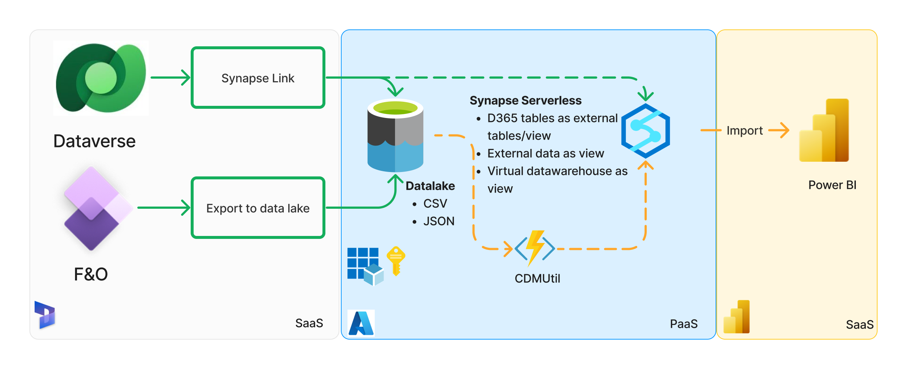
#1 Virtual data warehousing: Synapse Link & Export to data lake, with Synapse Serverless
Old pattern

Slide 26
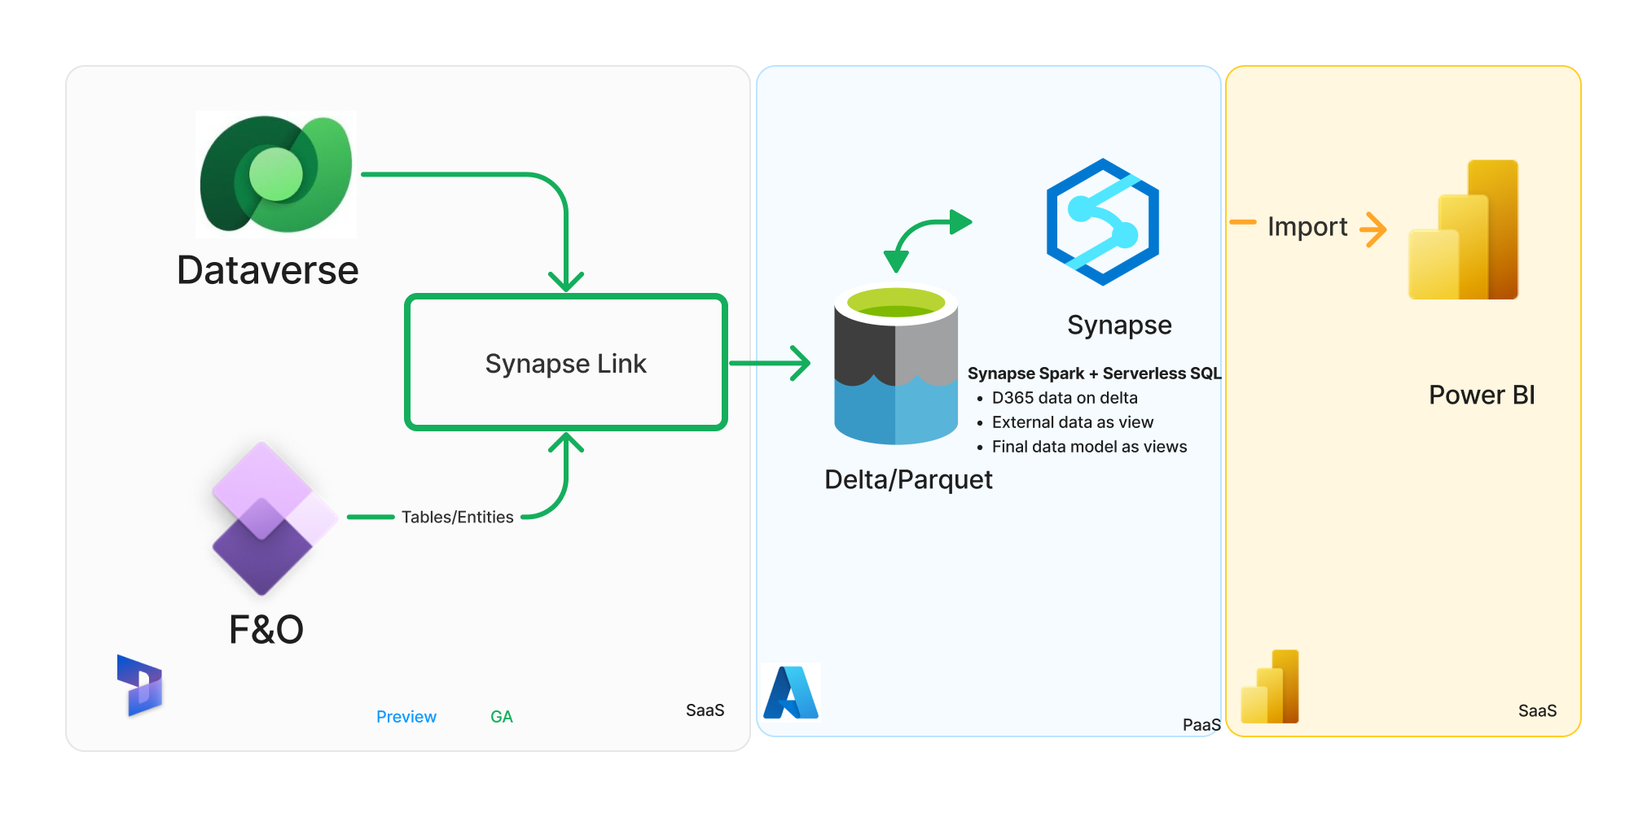
#1 Virtual data warehousing : Synapse Link (BYOL) with Synapse Spark & Serverless
New pattern with Synapse Analytics
Notes:
Simplified user experience to export all Dynamics 365 data
Secure storage account with MSI access
Convert F&O Tables on CSV with delta – Better perf and lower query cost
Transition to Fabric with ease using DV Fabric shortcuts

Slide 27
Step-by-step: Transition virtual datawarehousing using Synapse Spark +Serverless
Prerequisites
Extract Synapse serverless objects, use SSDT tool to automate. (Other than F&O tables views created by CDMUtil)
Setup Synapse Link for finance and operations apps data: Link
Configure Azure Synapse Workspace and Spark Pool Link
# | Steps
1 | Create a new SQL database in Azure Synapse Serverless.
2 | Create VIEWs in the new database for tables/entities.
3 | Deploy additional objects on new database
4 | Update downstream applications to new serverless db.
5 | Validate end-to-end solution
Sample SQL Script:
/DataverseLink/VirtualDatawarehouse/EDL_To_DVLink_DataVirtualization.sql
Considerations
When creating the VIEWs within the serverless database you can add audit column names as those in the Export to data lake feature, this will reduce the effort on updating pipelines etc… that use those columns.

Slide 28
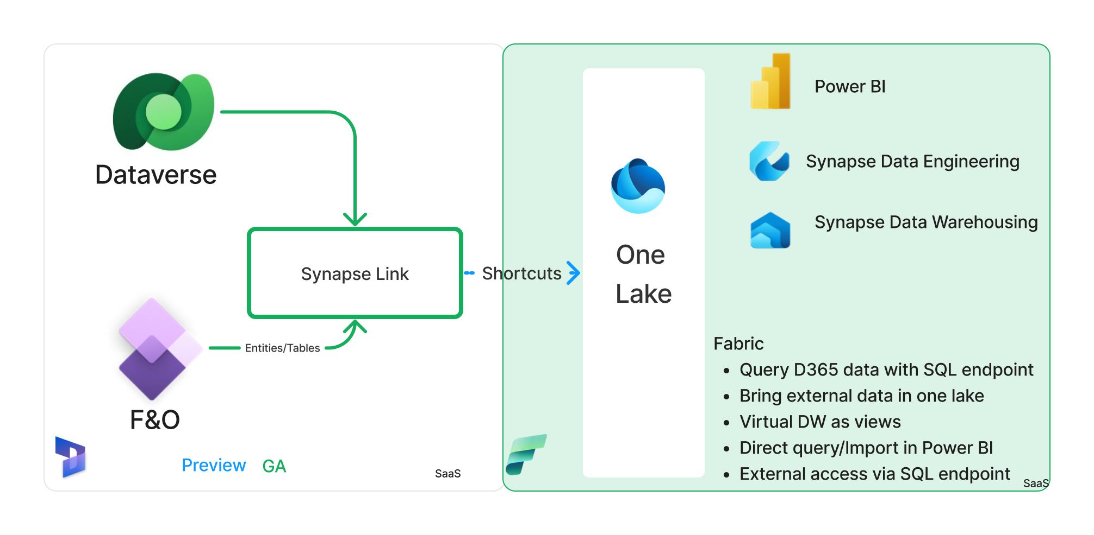
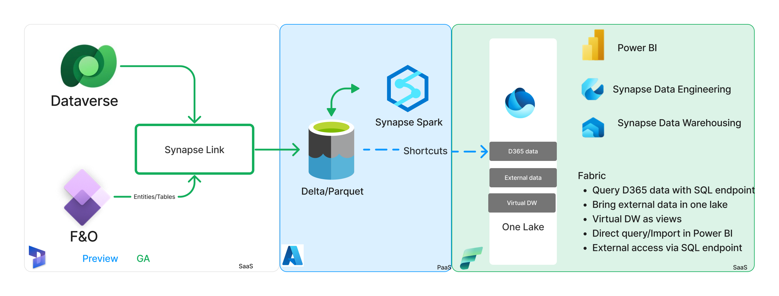
#1 Virtual data warehousing: Microsoft OneLake, with Microsoft Fabric
Link to Fabric
New pattern with Microsoft Fabric
Notes:
When planning to use Microsoft Fabric, you can either use Link to Fabric. The difference between option 1 or 2

Slide 29

Lakehouse architecture migration path

Slide 30
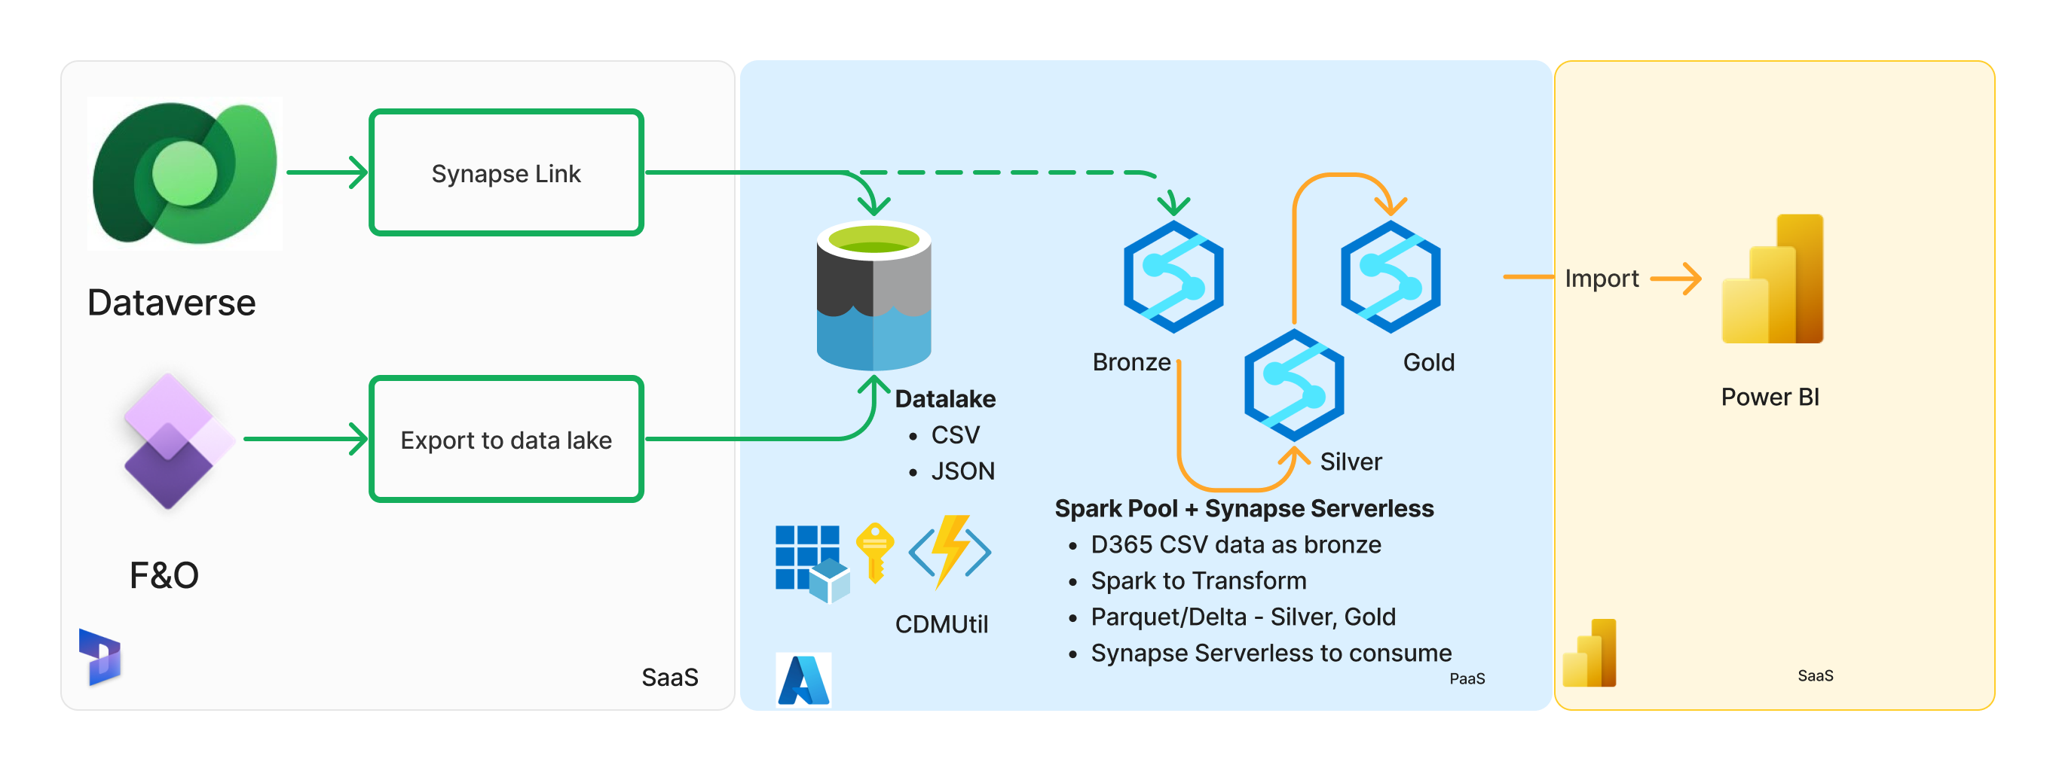
#2 Lakehouse : Synapse Link/Export to Data lake, with Synapse Spark & Serverless
Old pattern
Notes:
Synapse Spark or Databrick spark to create silver and gold layer
Synapse Serverless as consumption layer
Data transformation using notebooks and pipelines
Power BI import mode for final data

Slide 31
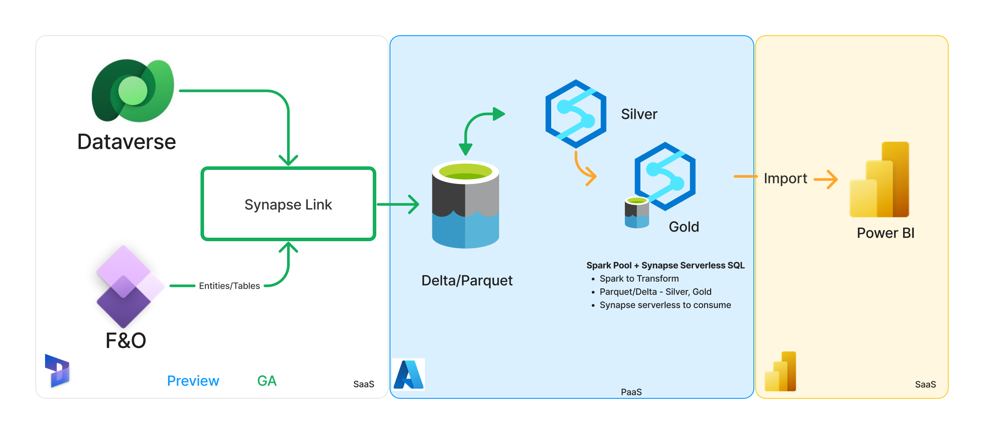
#2 Lakehouse : Synapse Link (BYOL), with Synapse Spark and Serverless
New pattern with Synapse Analytics
Notes:
Synapse Spark or Databrick spark to create silver and gold layer
Synapse Serverless as consumption layer
Data transformation using notebooks and pipelines
Power BI import mode for final data

Slide 32
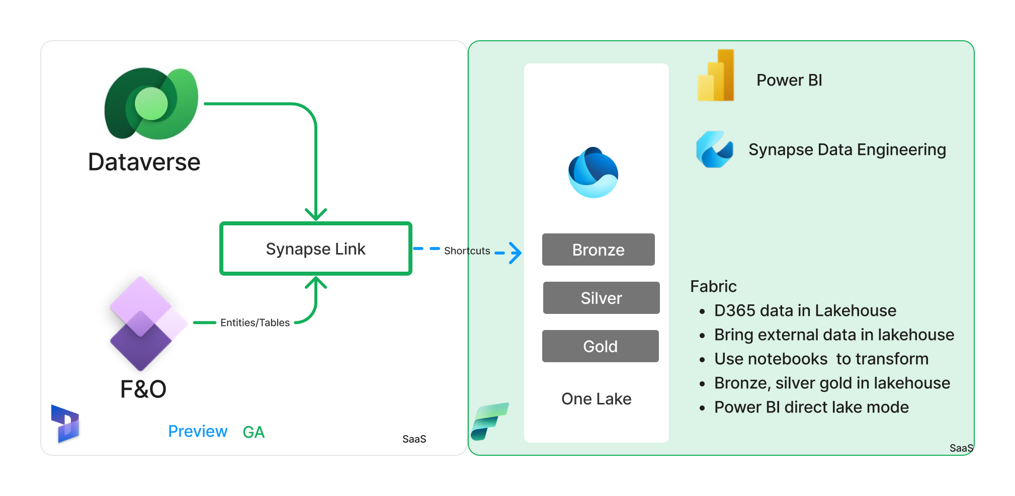
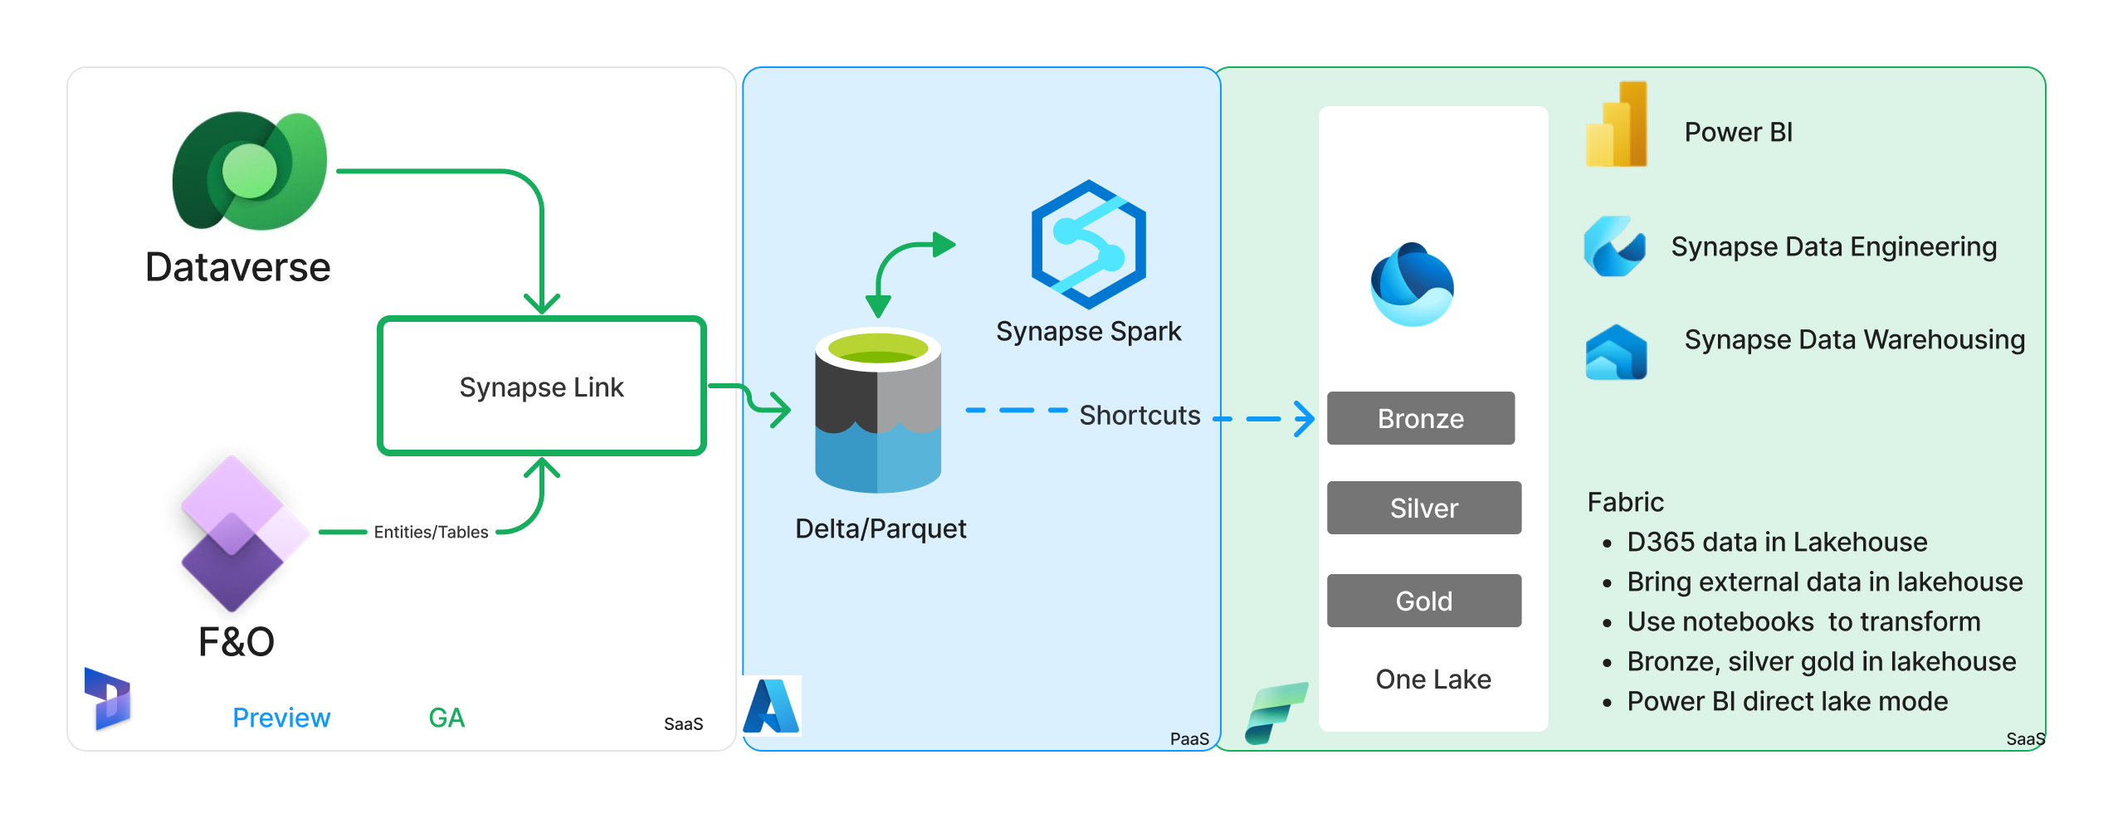
#2 Lakehouse : Microsoft OneLake, with Fabric
Link to Fabric
New pattern with Microsoft Fabric
Notes:
Synapse Spark or Databrick Fabric to create silver and gold layer in OneLake
Synapse Serverless Fabric SQL endpoint as consumption layer
Data transformation using notebooks and pipelines
Power BI import direct lake mode for final data

Slide 33

Cloud data warehousing migration path

Slide 34
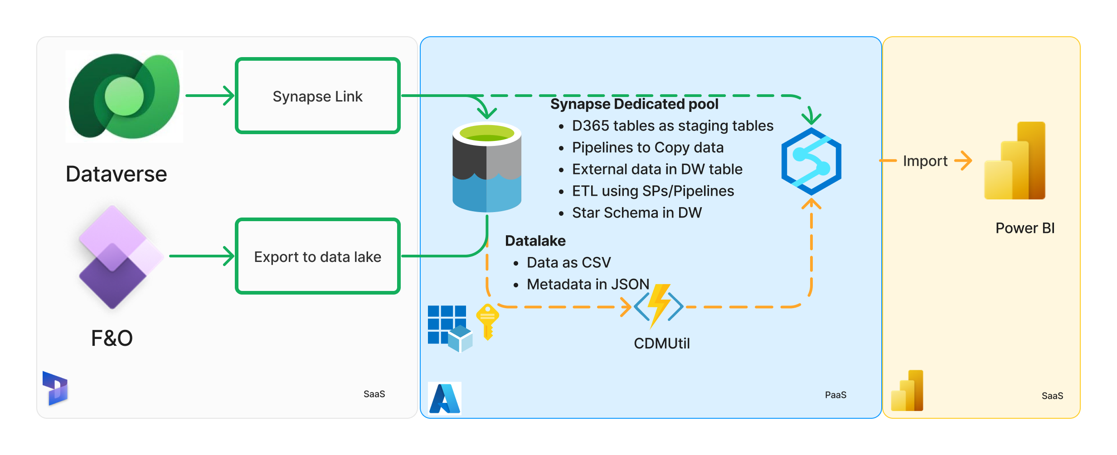
#3 Cloud data warehousing: Synapse link/ Export to data lake with Synapse DW
Old pattern
Notes:
Data copy pipeline to copy data to DW
Cross database query not supported
Data transformation using SPs and pipelines
Power BI import mode of final data or direct query mode

Slide 35
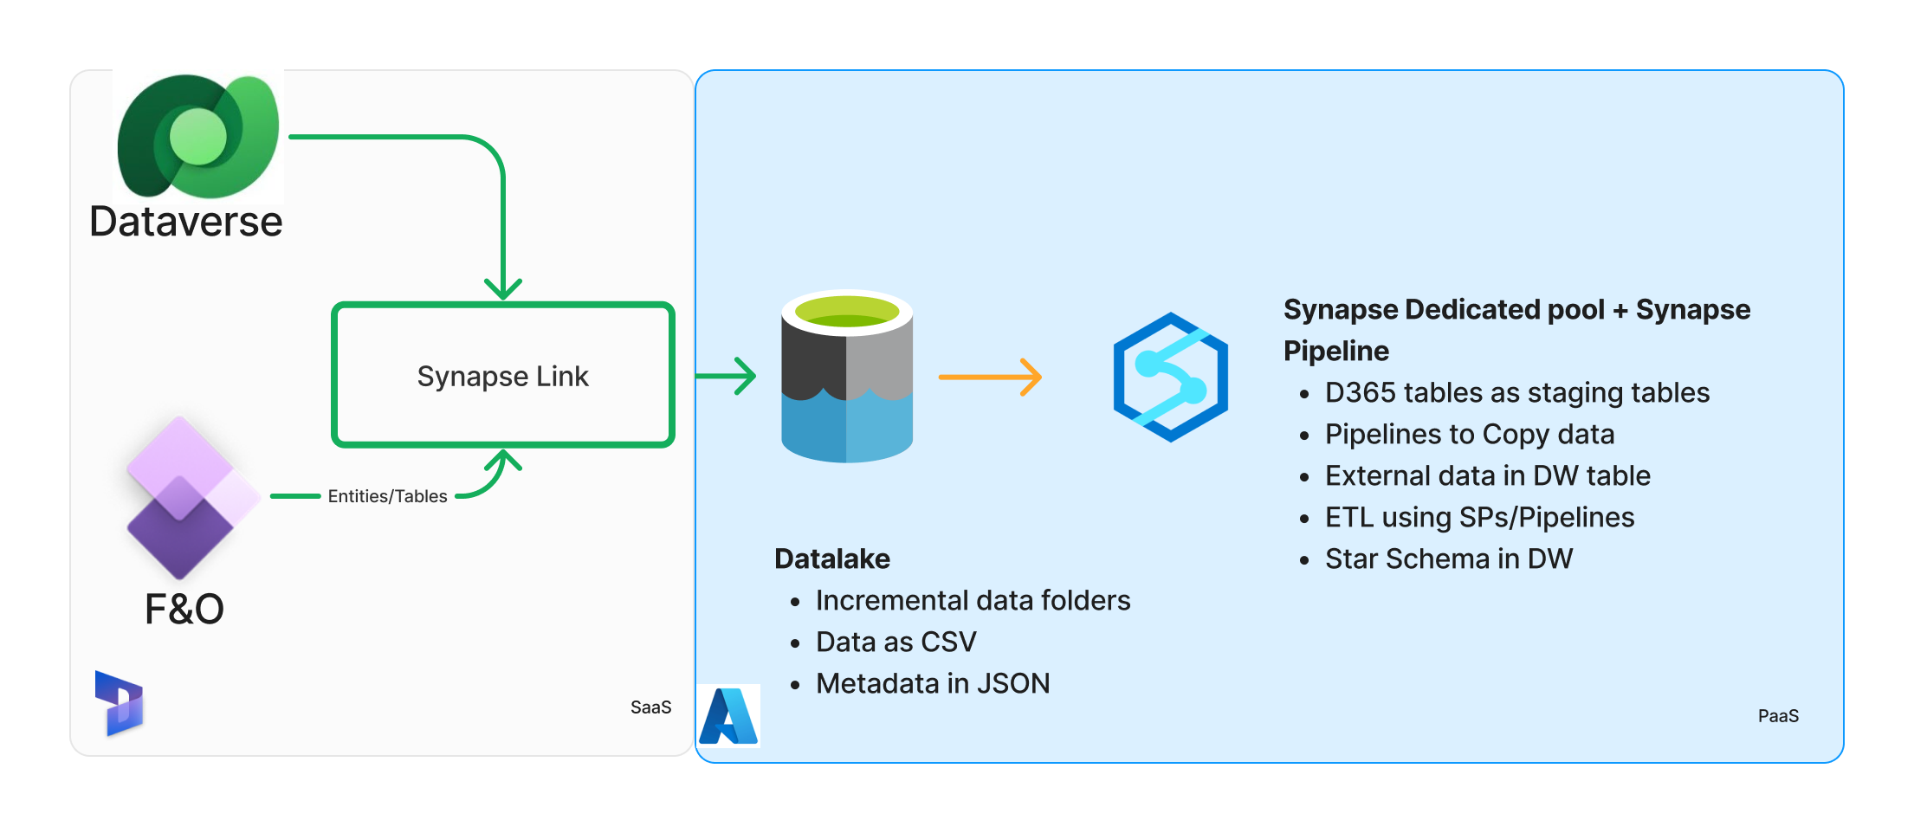
#3 Cloud data warehouse: Synapse Link (BYOL) with Synapse Pipelines and Dedicated pool
New pattern with Synapse dedicated pool
Notes:
Data copy pipeline to copy data to DW
Cross database query not supported
Data transformation using SPs and pipelines
Power BI import mode of final data or direct query mode

Slide 36
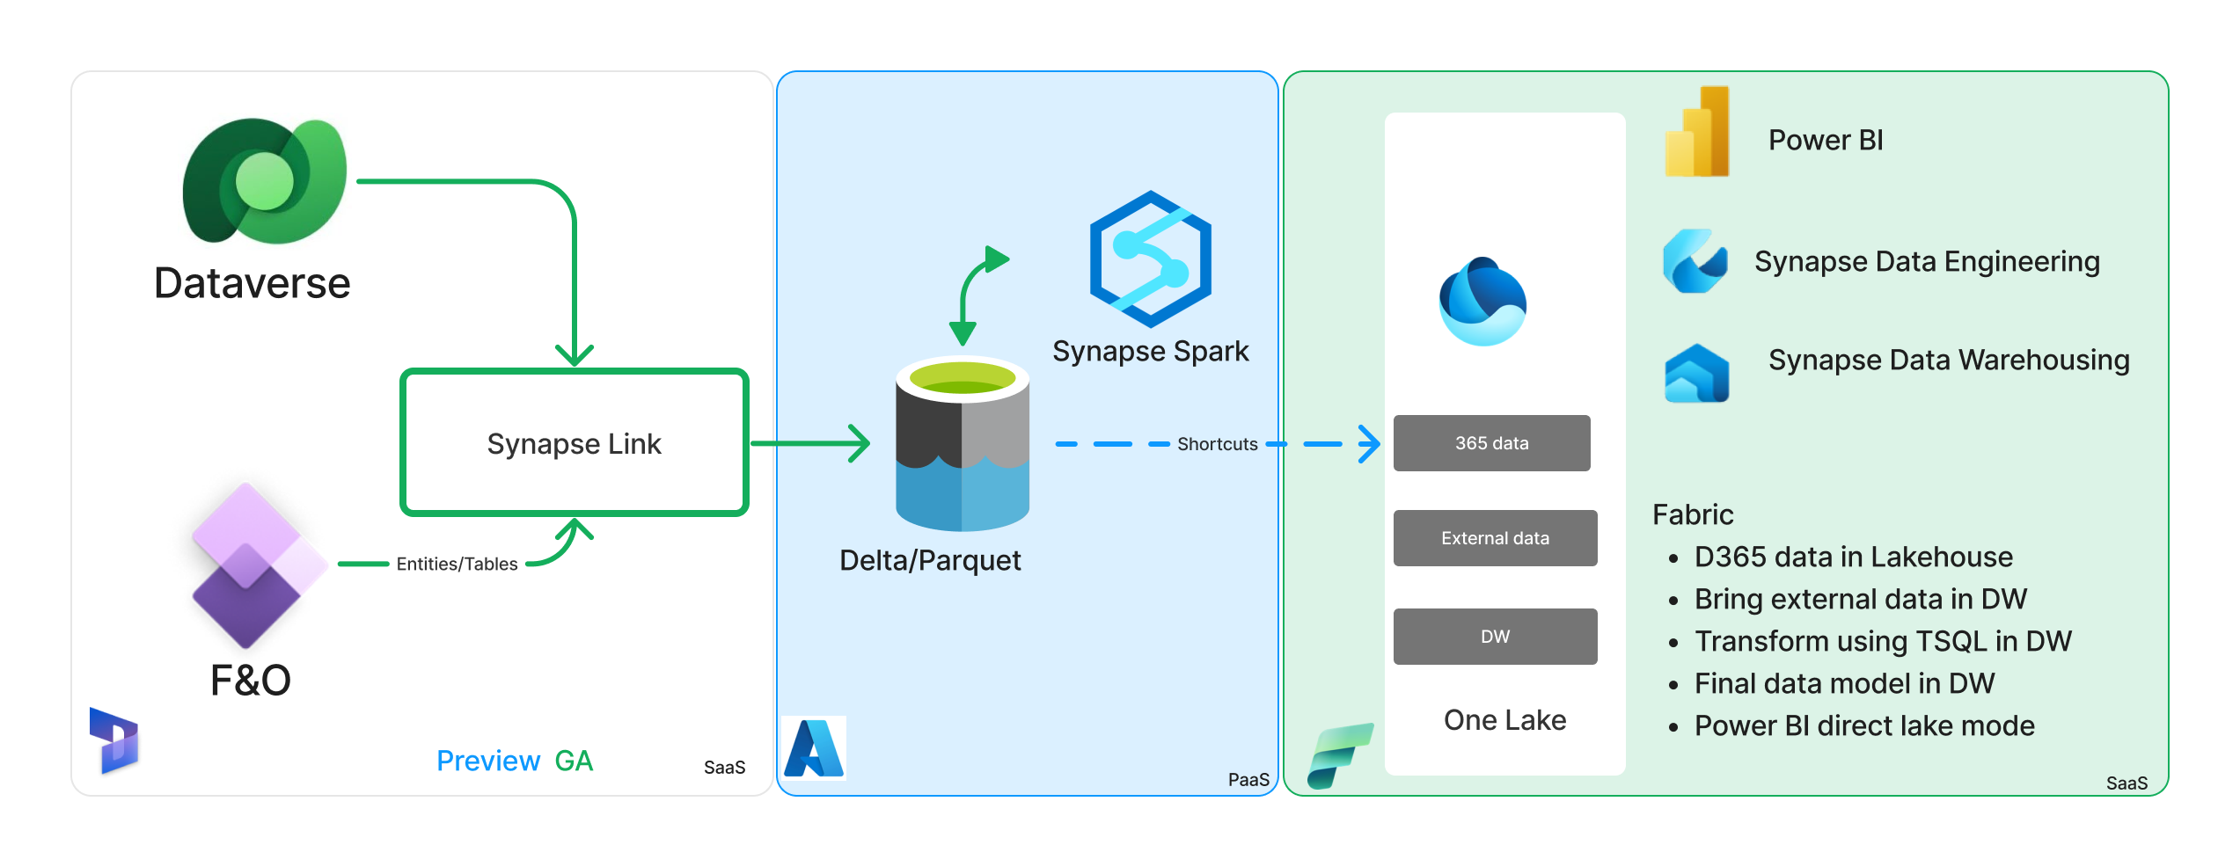
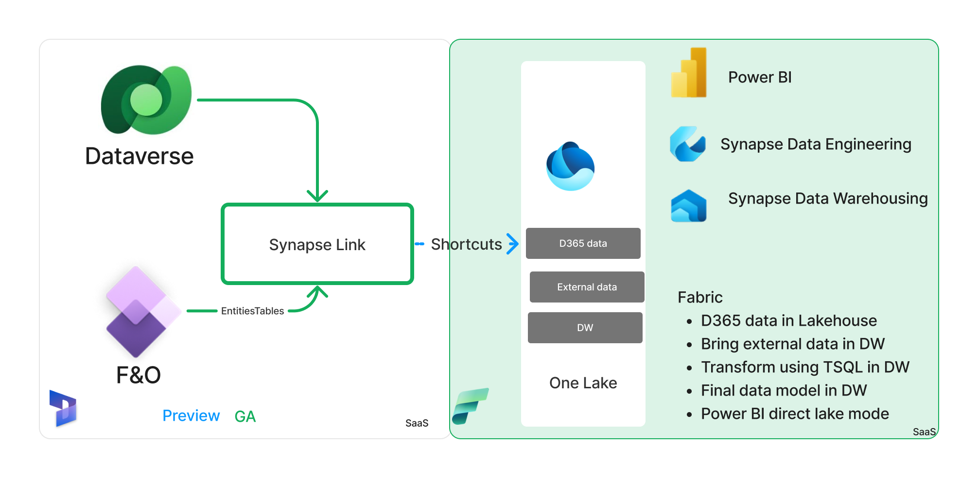
#3 Cloud data warehouse: Synapse Link (BYOL) with Microsoft Fabric
Link to Fabric
New pattern with Microsoft Fabric
Notes:
Data copy pipeline to copy data to DW
Cross database query not supported
Data transformation using SPs and pipelines
Power BI import mode of final data or direct query mode

Slide 37

3rd party integration migration path

Slide 38
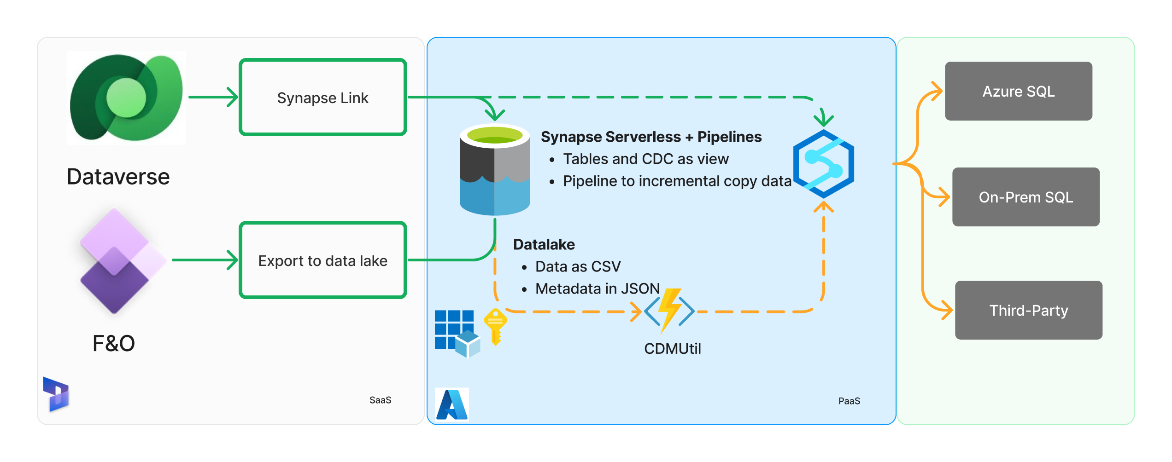
#4 Integration using SQL: Synapse Link/Export to Data lake with Azure SQL, On-prem SQL, third-party using Synapse
Notes:
CDMUtil to create views for Tables folder and ChangeFeed folders
Initialize data from Table folder
Using Change feed pipelines to incrementally copy data
When table is re-initialized, full copy is needed

Slide 39
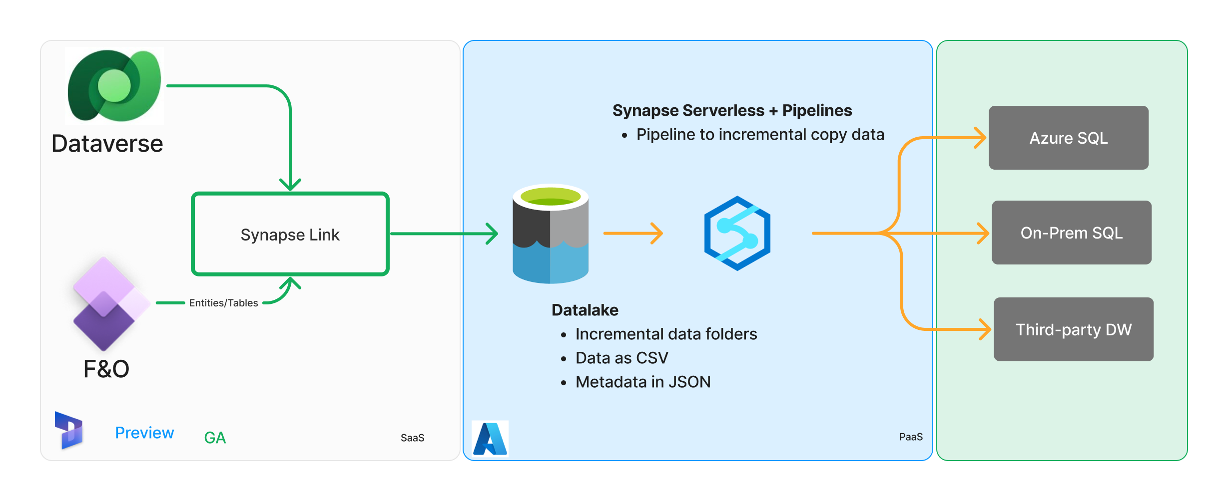
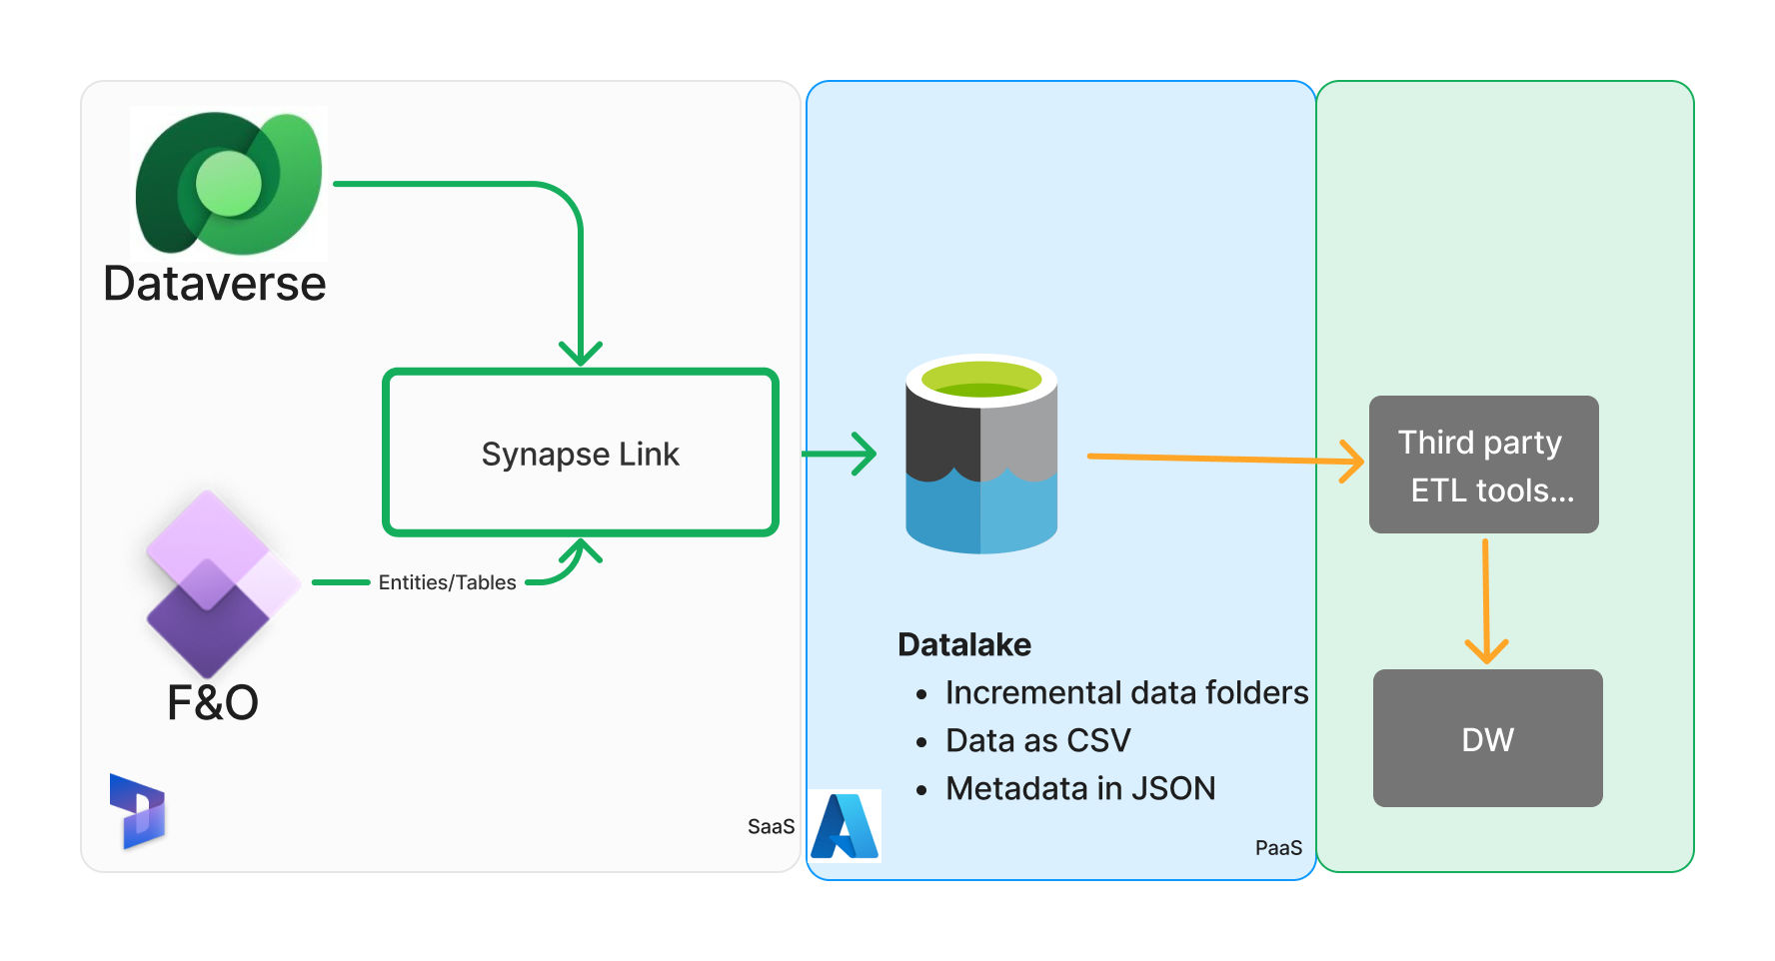
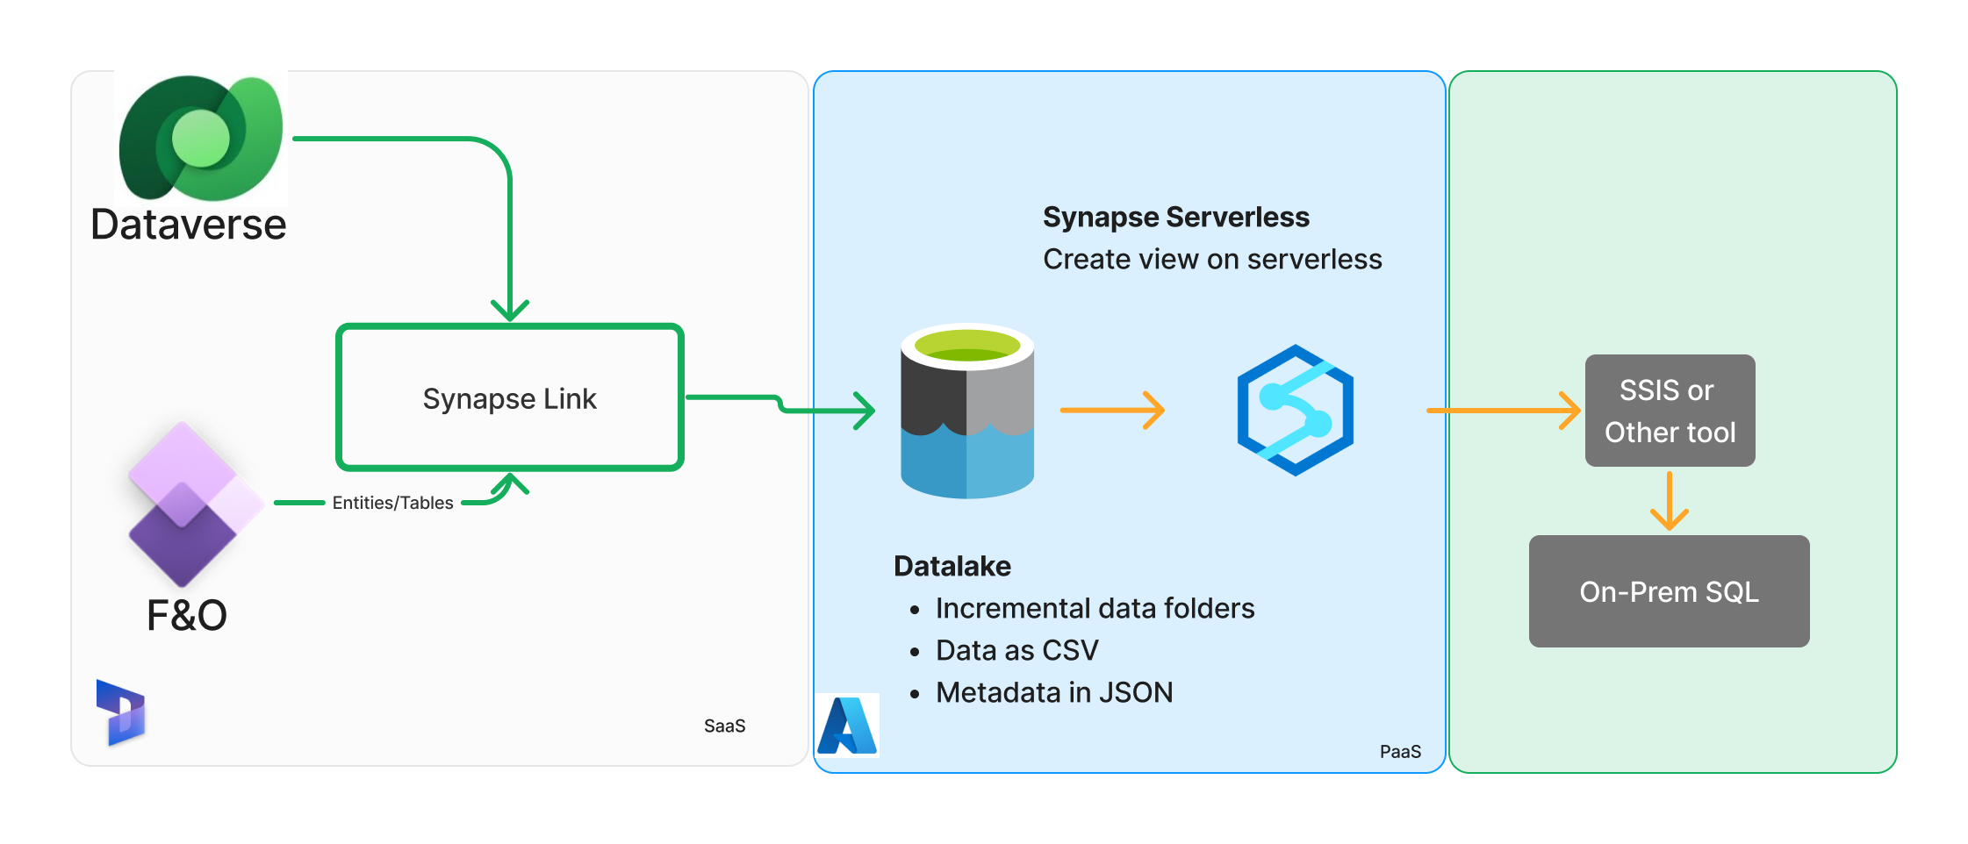
#4 Integration using SQL: Synapse Link - Export data to your lake with Azure SQL, On-prem SQL, third-party using Synapse
Notes:
CDMUtil to create views for Tables folder and ChangeFeed folders
Initialize data from Table folder
Use Change feed pipelines to incrementally copy data
When table is re-initialized, full copy is needed
*Incremental folder for F&O Tables are not yet available – but coming soon

Slide 40
Step-by-step: Incremental data ingestion using Synapse Serverless and Pipelines
Prerequisites
Setup Synapse Link for finance and operations apps data: Link
Configure for incremental folder update feature Link
# | Steps
1 | Create synapse workspace and serverless SQL database.
2 | Create views on Synapse serverless db for table/entities on incremental folders
3 | Create ADF/Synapse pipeline to read new folders, copy incremental data from serverless views, de-duplicate and merge data to target database
4 | Schedule pipeline to periodically copy incremental data
5 | Validate existing ETL logic on the target SQL database
Pipeline to help:
DataverseLink/DataIntegration

Slide 41
Comparing – Incremental folder vs ChangeFeed folder
 | ChangeFeed | Incremental
File path to schema | <container>/ChangeFeed/<table name>.cdm.json | <container>/<folder name>/model.json Folders are named by creation timestamp ("yyyy-MM-dd'T'HH:mm:ss.SSSz") in UTC.
File path to data | <container>/ChangeFeed/<table name>/<file name>.csv | <container>/<folder name>/<table name>/<filename>.csv
Changed data identification | Use the Modified datetime on the individual CSV files | Use the name of the folder and model.json size does not equal 0
Column differences | Detailed here | Detailed here
Full push | Old files within <container>/ChangeFeed/<table name>/ deleted and new files created after table initialised | All records sync’d to latest folder <container>/<folder name>/<table name>/<filename>.csv
Additional details | ChangeFeed folder feature | Incremental folder feature

Slide 42
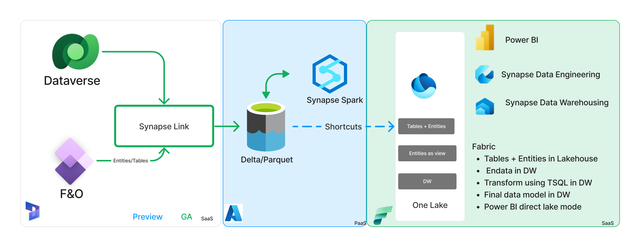

#5 BYOD Replacement: Synapse link and Microsoft Fabric

Slide 43
Appendix
6
Links to Tech talks
Product screen shots and details
Documentation

Slide 44
Resources
Documentation
Synapse Link
Azure Synapse Link - Power Apps | Microsoft Learn
Create an Azure Synapse Link for Dataverse with your Azure Synapse Workspace - Power Apps | Microsoft Learn
Export Microsoft Dataverse data in Delta Lake format - Power Apps | Microsoft Learn
Choose finance and operations data in Azure Synapse Link for Dataverse - Power Apps | Microsoft Learn
Use managed identities for Azure with your Azure data lake storage - Power Apps | Microsoft Learn
Microsoft Fabric
Dataverse direct integration with Microsoft Fabric - Power Apps | Microsoft Learn
Microsoft Fabric documentation - Microsoft Fabric | Microsoft Learn
Yammer group
Viva Engage- Synapse Link for Dynamics
Video
Dataverse
Dynamics 365 Bites - Synapse Link for finance and operations apps - Getting started (preview) | August 2023
(2747) Build 2023: Dataverse integration for Microsoft Fabric - YouTube
Microsoft Fabric
(2747) Microsoft Fabric: Satya Nadella at Microsoft Build 2023 – YouTube
Microsoft Fabric Launch Digital Event (Day 1) – YouTube

Slide 45
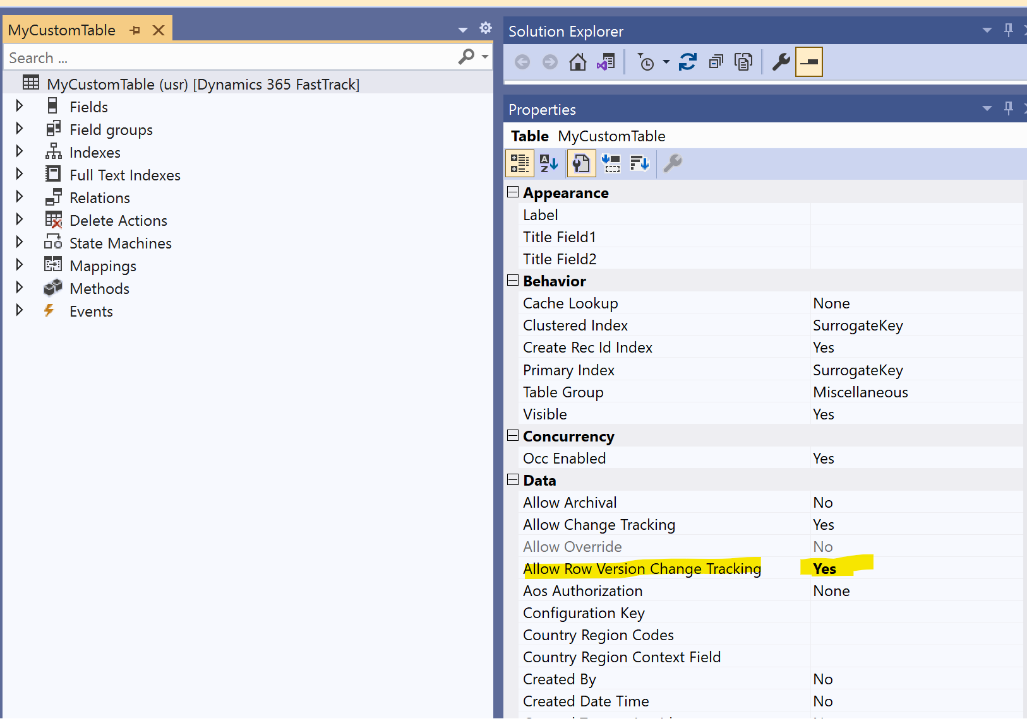
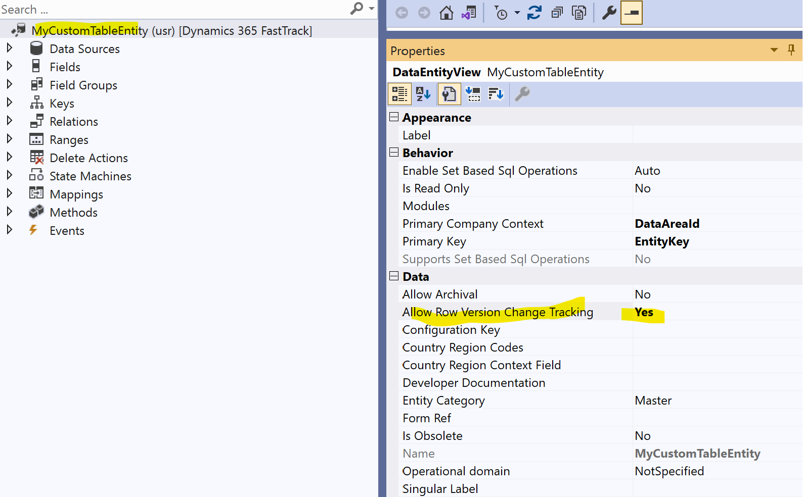
Allow Row Version Change Tracking
Row version CT property must be enabled on tables
1600+ OOB tables already have it enabled (most common used with Export to data lake)
Row version CT property is extensible – Developer can extend the property for any tables that is not enable OOB
Custom and ISV tables needs a property enabled on table to make it available (one-time small dev work)
Notes:
Change a single property to export custom tables and entities. Set Allow Row Version Change Tracking to Yes.

Slide 46
CSV vs Delta lake
Factor | CSV | Delta Lake
File Size & Storage Efficiency | Text format, larger file size, no built-in compression | Columnar format, smaller file size, built-in compression
ACID Transactions | Not supported, may lead to data corruption during write failures | Supported, ensures data integrity
Performance | Slower read/write due to row-oriented storage | Faster read/write due to columnar storage and statistics
Data Virtualization | Less efficient due to performance and schema evolution limitations | More efficient due to performance optimizations and schema evolution support
Data Processing (Transformation) | Not optimized, longer processing times, higher resource usage | Efficient supports data processing
Schema Evolution | Schema changes may require data rewriting (Export to data lake – support schema drift on new column) | Built-in support for schema evolution
Metadata Handling | No built-in metadata handling, managed separately. Export to data lake manage metadata using cdm.json | Built-in metadata handling alongside data
Compatibility | Widely supported, easy to use with various tools and platforms | Open-source data format – widely used for BI and Analytics workload.

Slide 47
Comparing incremental change technology
Feature/Aspect | CDC (Export to data lake) | Change tracking (BYOD) | Row version CT (Synapse link)
What it captures | Changes (Inserts, Updates, Deletes) with historical data. | Which rows have changed (Insert, Update, Delete) without historical data. | Changes via a version column; doesn't provide historical data.
Overhead | Low to Moderate. | Low to Moderate. | Low. Only the version number increments.
Storage | Stored in change tables separate from the original table. | Metadata only, so less storage overhead. | Additional integer column in the table for the version.
Query Mechanism | System functions and change tables. | CHANGETABLE function. | Standard SQL queries using the version column.
System Impact | Log and IO impact on due to the logging of changes. | Querying with CHANGETABLE on large dataset with extended time can cause blocking. | Minimal impact; only an increment operation.
Recovery from failure/Failover /DR | Full export if CDC retention period is missed, Failover or Disaster recovery | Full export if CT retention is missed | Changes are retained in the database- No full export needed

Slide 48
Data sync state column differences
Synapse link | Description | Equivalent columns in Export to data lake
Id | Unique value for each row like RecId, generated to for compatibility between F&O and CE platform | Not applicable
SinkCreatedOn | Datetime stamp when the data is written to datalake | DataLakeModified_DateTime
SinkModifiedOn | Datetime stamp when the data was updated in delta lake | DataLakeModified_DateTime
 |  | LastProcessedChange_DateTime
versionnumber | The versionnumber column is an automatically incremented binary number, that updates every time a row is inserted or modified in a table. Can be used as marker for incremental data processing. | LSN
isDelete | Rows that are hard deleted in the source will be marked as isDelete = true in the incremental CSV file. | NA

Slide 49
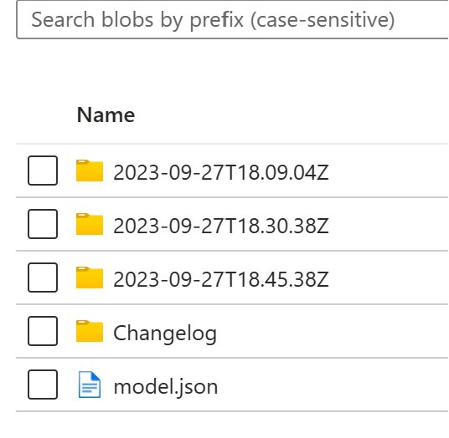
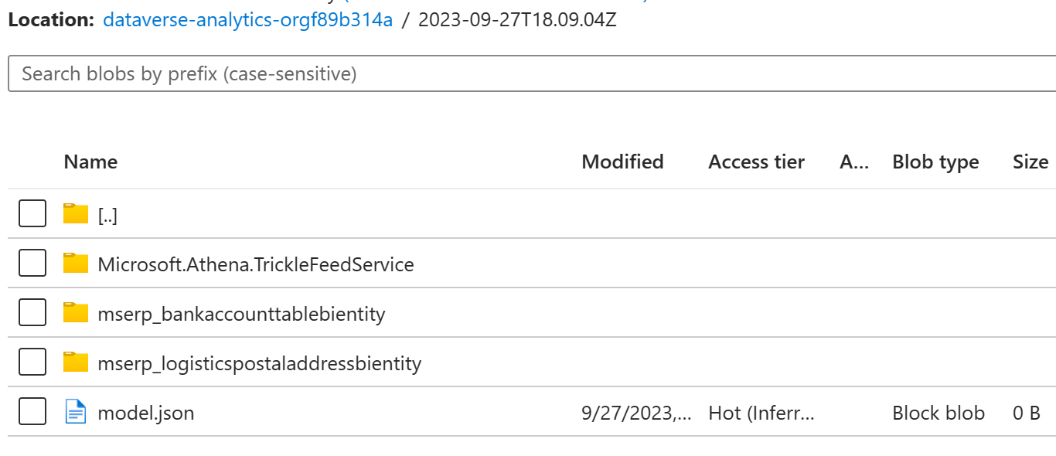
Understanding – Incremental folder
Incremental folder feature
An Incremental profile is created in maker portal with storage account only
When table is added to incremental folder profile, system start initial export, when complete, table is marked as Active.
In Active state, incremental changes in the tables copied to data lake in near real time.
Initial data as well as incremental data follows the same pattern and folder structure in the data lake.
Folder created with name creation timestamp with format "yyyy-MM-dd'T’HH.mm.ss.SSZ“
Inside the timestamp folder, child folders are created with format “{tablename}” that contains csv data.
While data export starts a file model.json file is created with 0 bytes. You should not read the data from the folder, until model.json file is updated.
Once data write complete/update frequency is reached (example 15 min), model.json file is updated with tables metadata under the timestamp folder to mark completion of the folder.
Once previous folder is complete, a new folder get created and process continues.

Slide 50
Incremental folder data processing - Ideas
Type | Trigger point | Pre-Processing | Data read | Data copy | Post processing | Examples
Event based | Storage event – when model.json file under timestamp folder is updated size not 0 Pass the {timestampfolder1} |  | Read each tables {ftimestampfolder1}/{tablename} CSV data | De-duplicate the data on VersionNumber and ID Upsert the rows matching or ID Delete the rows where IsDelete = True |  | Coming soon
Batch mode | Specified time interval | Create a high watermark marker – foldername Identify list of folder completed since last watermark {folder1,folder2} | Read each folder {folder1}/{tablename} , {folder2}/{tablename} folders CSV |  | Update marker with largest timestamp foldername processed | Coming soon

Slide 51
Known issues, gaps, workarounds and timeline as of Oct 2023
# | Workaround | Fix ETA
Enum columns have values(no, yes) instead of id (0,1) | Create view for each table and translate enum back from string to int (SQLScript to ) | Nov
Missing columns in table like DirPartyTable | Create a view and join base tables and derived table
Few kernel tables (DataArea,UserInfo) are missing | Use alternate tables or data entities | Nov
F&O Tables support in Microsoft OneLake (Direct link to Fabric) | Use BYOL and view in Fabric | Nov 2023
Missing columns in table like custtable, (AOS validation, Array fields ) |  | TBD
Date Effective tables: expired rows are not exporting |  | TBD

